Slide 1
Results & Way Ahead
20 October 2022
PAMPLONA, SPAIN

Slide 2
Results Planning Committee Meeting
Annual Report 2020/21
  Participants
  Permanent Guests
Task to Syndicate CapDev: Mountian Cell
Development of the Initiative
  Further development of possibilities for common training
  Draft structural Concept of an intern. „Training and Education Team“
Task DEU and AUT to further develop the topic LI/LL for the Exercise series Berglöwe

Slide 3
Programme of Work 2023 and following
Expert Talks HRV TBD (Apr - May 2023)
  IPC Rhodope 24
9th PCM & 2023 Annual Conference AUT (Sep – Oct 2023)
Recce AUT, DEU?, Rhodope 24 Mar 2023
IPC Alpine Defense 24, May 2023
Berglöwe 23 3 weeks in Oct 23
MPC Rhodope 24 Sep – Oct 2023
MPC Alpine Defense 24, 4/4 2023
Rhodope 23 no MTI Event anymore

Slide 4
Programme of Work 2023 and following
Rhodope 24; 2 weeks end of Mar 2024
FCC Alpine Defense 24, 2/4 2024
Alpine Defense 24 (two Weeks during Week 38 – 41 2024 TBD)
Berglöwe 25 ¼ 2025 (winterly conditions)

Slide 5
Results Needs & Offers
20 October 2022
PAMPLONA, SPAIN

Slide 6
Results N&O –
8th PCM & 2022 Annual Conference
MTAs 2023
Way Ahead MTAs 2024
Open Points

Slide 7
MTA 2023 - BEL
Requested by | BEL | BEL
Location/MTA (desired) | Prio1: MTA HOCHFILZEN Prio2: MTA SEETALER ALPE | Prio1: MTA HOCHFILZEN Prio2: MTA SEETALER ALPE
Country | AUT | AUT
Unit | 2 Cdo | 3 Para
Requested time (from - to) | Prio1: 12.-24. February 2023 Prio2: 27. February - 10. March 2023 | weeks 5-6 (30. January - 11. February 2023)
Number of PAX | 80 | 100
Planned activities: | Living, mobility & shooting in winter condtions | Winter movement, survival and warfare Living, Mobility & Shooting in winter conditions
shooting ranges | Yes | Yes
Weapon Systems/Calibers/ Ammo | Assault Rifle: 5,56 / 5,7 / 7,62 mm AX .338 Mor 60mm Mgun 7,62 / 12,7 mm | Assault Rifle: 5,56 / 5,7 / 7,62 mm Sniper Rifle: .50 / .338 / 7,62 mm Mor 81 mm M Gun 7,62 / 12,7 Gren 40 mm / LAW / RGW89
Remarks | 1 AUT Military Mountain Guide (HBF) | 1 AUT Military Mountain Guide (HBF)
 | MTA HOCHFILZEN: 13-24 February 2023 | MTA SEETALER ALPE: 30 January – 11 February 2023

Slide 8
MTA 2023 - BEL
Requested by | BEL | BEL
Location/MTA (desired) | Prio1: MTA LIZUM Prio2: MTA SEETALER ALPE | Prio: MTA LIZUM
Country | AUT | AUT
Unit | 12/13 Li | 1 C/1 GR
Requested time (from - to) | Two weeks December 2023 | 6.-24. March 2023
alternative time (from - to)
Number of PAX | 80 | 120
Planned activities: | Living, Mobility & shooting in winter condition | Winter movement, survival and warfare living, mobility and shooting in winter conditions
shooting ranges | Yes | Yes
Weapon Systems/Calibers/ Ammo | Assault Rifle: 5,56 / 5,7 / 7,62 mm Mor 60 mm M Gun 7,62 / 12,8 | Assault Rifle: 5,56 / 5,7 / 7,62 mm Mor 60 mm M Gun 7,62 / 12,7 Gren 40 mm / LAW / RGW90
 | MTA LIZUM: CW 50 & 51 2023 | MTA Lizum: 11 – 21 April 2023

Slide 9
MTA 2023 - CZE
Requested by | CZE | CZE
Location/MTA (desired) | MTA HOCHFILZEN thomas.abfalter@bmlv.gv.at | MTA LIZUM
Country | AUT | AUT
Unit | CZE Army Snipers
Requested time (from - to) | February 2023 (5 Days) | Aprill 2023 (12 Days)
Number of PAX | 10 | 80
Planned activities: | Sniper Deployment Tactics / Life Firing | Tactics, OPS planning, OPS C2, Life Firing
shooting ranges | YES | YES
Weapon Systems/Calibers/ Ammo | .308Win, .50BMG | 5.56 NATO; 7.62 NATO; 308WIN; .50BMG
Remarks | Request: Q2 Instructor, Sniper Instructor (Tactics, Balistics) | Request: Q2 Instructor (COY lvl experience)
 | MTA HOCHFILZEN: 27. February - 3. March | MTA HOCHFILZEN: CW 14 & 15 ?? RüMe CZE

Slide 10
MTA 2023 - NLD


Slide 11
Way Ahead – MTA/AUT 2024
Needs/Requests NLT 31 March 2023 via E-Mail to :
office.mti@bmlv.gv.at
Feedback from AUT about GO or NO GO → NLT August 2023
No more direct „booking“ of MTA/AUT!

Slide 12
Way Ahead – MTA/AUT 2024
New Request Format will be created and send out to the MTI-Community

Slide 13
Open Points

Slide 14
Training 2023
AUT / Military Mountain Instructor Course Winter (MMIC W)
Request for an instructor
AUT / Int. Military High Mountain Instructor Course (MHMIC)
Request for an instructor

Slide 15
Results Capability Developement
20 October 2022
PAMPLONA, SPAIN

Slide 16
Aim
Evaluation of Courses regarding to Training Architecture
Evaluation Allocation Chart
  New courses
  Changes
  Course Cancellations
Documents:
  Training Architecture
  Allocation Chart
  Required Capabilities
  Course Descriptions

Slide 17

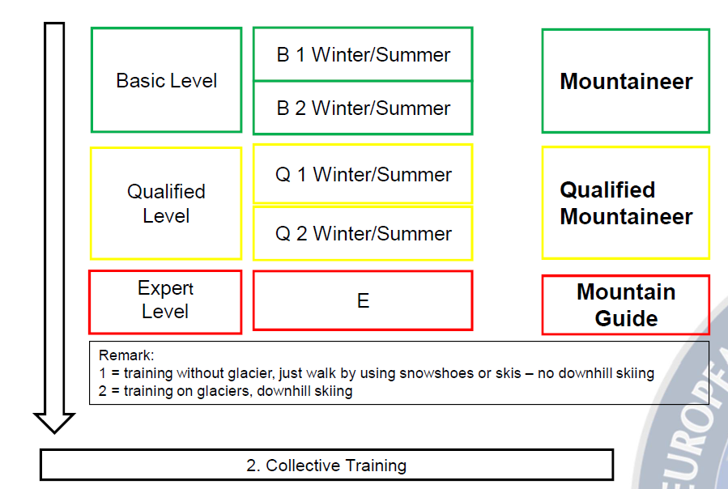

Slide 18
Required Capabilities
17_Q1_Su_Required Capabilities.pdf

Slide 19
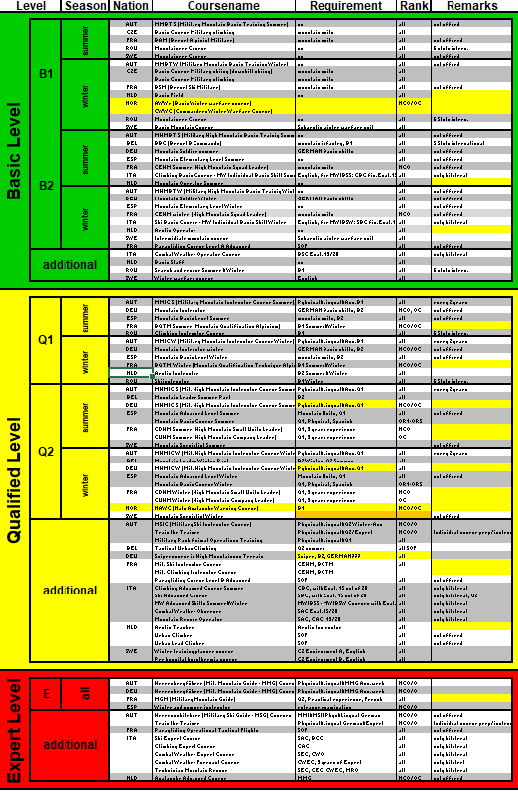
Allocation Chart
Allocation Chart 20oct22.xlsx

Slide 20
Course Description
GQ6310 Commando B.pdf

Slide 21
Refresher Courses
TBD

Slide 22
Way ahead
Expert Talks 2023:
  Follow up of AC22 (1/2 day)
  Combat Function „Protection in Mountain Warfare“ (MW COE)
  Mountain Cell (MDMP in Mountainous Environment)
  To be continued at AC2023

Slide 23
Results LI/LL
20 October 2022
PAMPLONA, SPAIN

Slide 24
Results LI/LL-syndicate work
Topic 1: Mountain Equipment Database
Topic 2: Fact Sheet
Topic 3: LI/LL-support to R-23/24

Slide 25
Results LI/LL – Topic 1 Database Mtn-Equipment
Database Mtn-Equipment
  General Datasheet: item/object, Photo, Company/Type of product
  Mtn-Equipment up to Platoon-level – TOE
  POC – procurement within nations
  Prorcurement outlook – 3-5 years
  Chatroom to request others to support
  Determine topic for ExT/AnnConf
  It is up to nations to contribute
  Task PC accomplished

Slide 26
Results LI/LL – Topic 2 Fact Sheet
Fact Sheet
  It is up to nations to contribute 15 DEC 22
  Task PC accomplished

Slide 27
Results LI/LL – Topic 3 LI/LL-support R-23/24
Follow NATO LI/LL-Process BUT
Increase the Focus on an Observation Database
To Avoid same „issues“
  LI/LL-Team brief on Observation Database
  Send a MTT to support planners RHODOPE
  BGR will invite via MTI

Slide 28
Results Platform

Slide 29
Timeline Minutes of the meeting
Draft minutes of the meeting: NLT: 04NOV22
Annotations: NLT: 18NOV22
Final minutes of the meeting: NLT: 25NOV22
Presentations and Minutes of the 8th PCM &
2022 Annual Conference will be on the platform

Slide 30
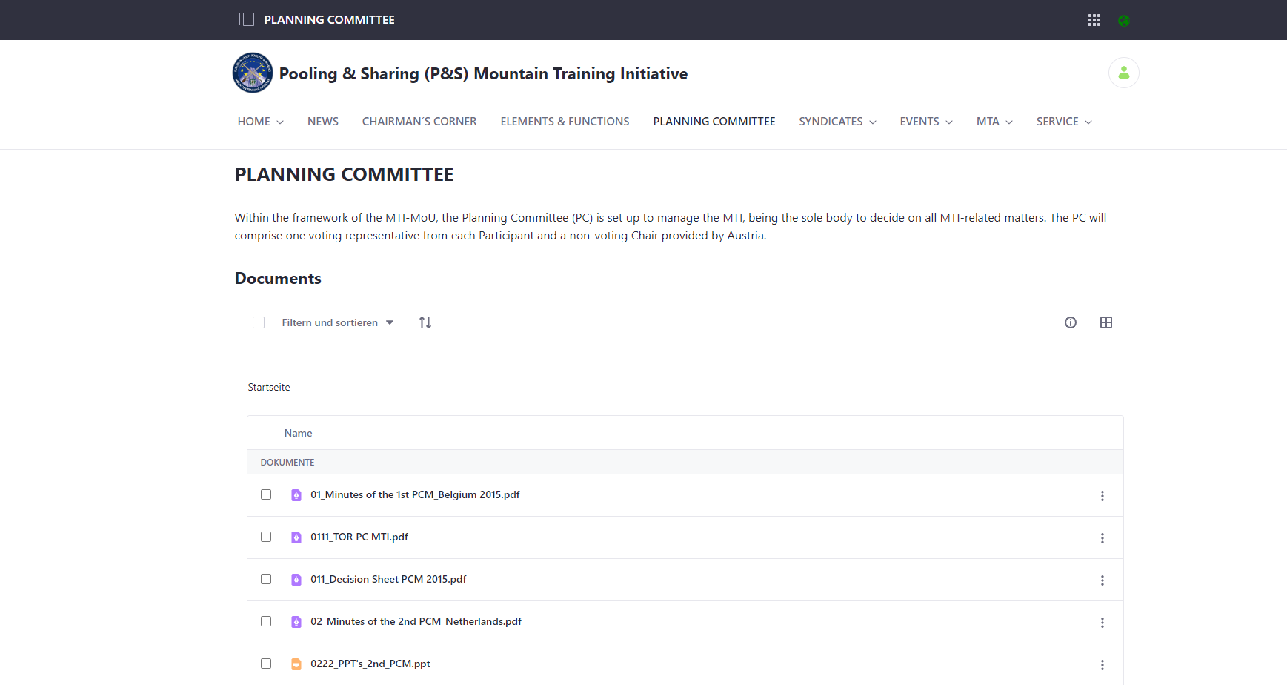

Slide 31
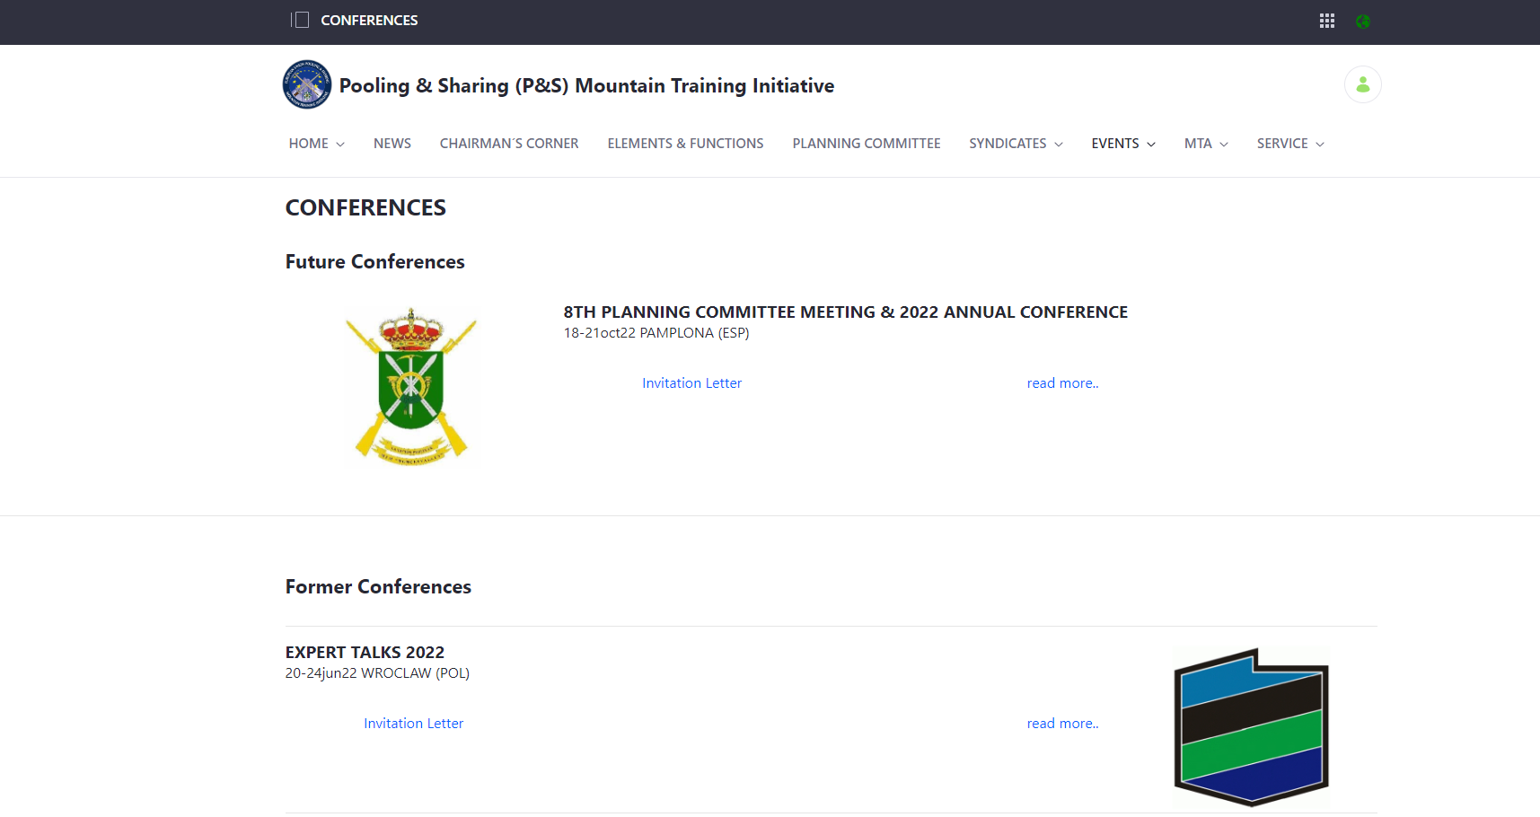

Slide 32
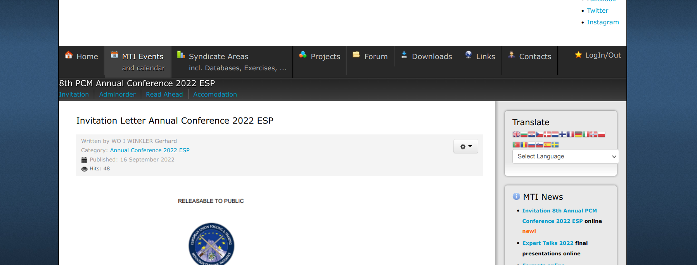

Slide 33
Further Communication
Invitations to and Minutes of the PCM
  for National Represantatives and POCs on the Platform
  to the respective MODs of MTI participants via the national Attaches
Invitations and Minutes of all other MTI events
  for National Represantatives and POCs on the Platform
  to the respective MODs of MTI participants, permanent guests and guests via the national Attaches
  office.mti@bmlv.gv.at

Slide 34






Closing Remarks
Participants:
AUT
BEL
BGR
CZE²⁾
DEU
ESP³⁾
FRA⁴⁾
HRV
NLD
POL
SVN
SWE¹⁾
Observer:
Permanent Guest:
NATO
MW COE
Guests:
ITA
ROU
¹⁾ since 28th Nov 2016
²⁾ since 6th Dec 2017
³⁾ since 26th Oct 2020
⁴⁾ since 22th Sep 2022

