Slide 1
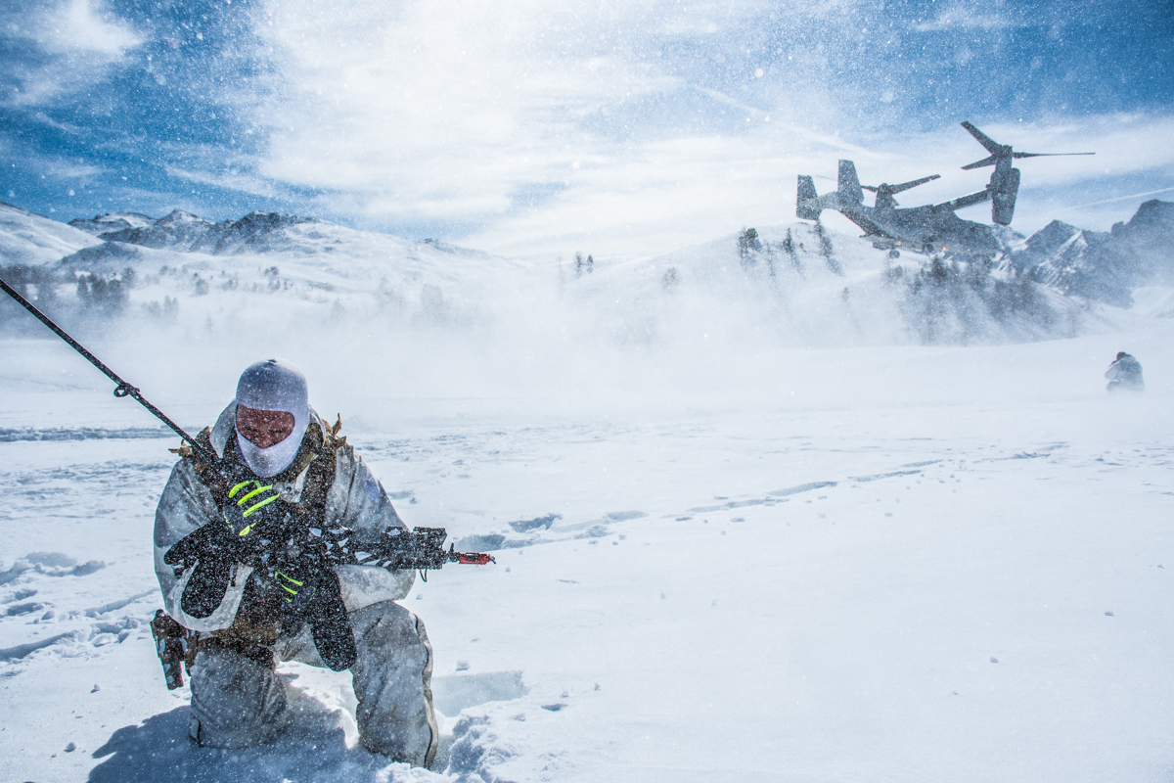
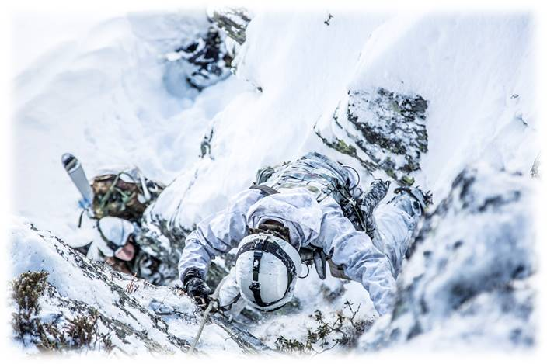
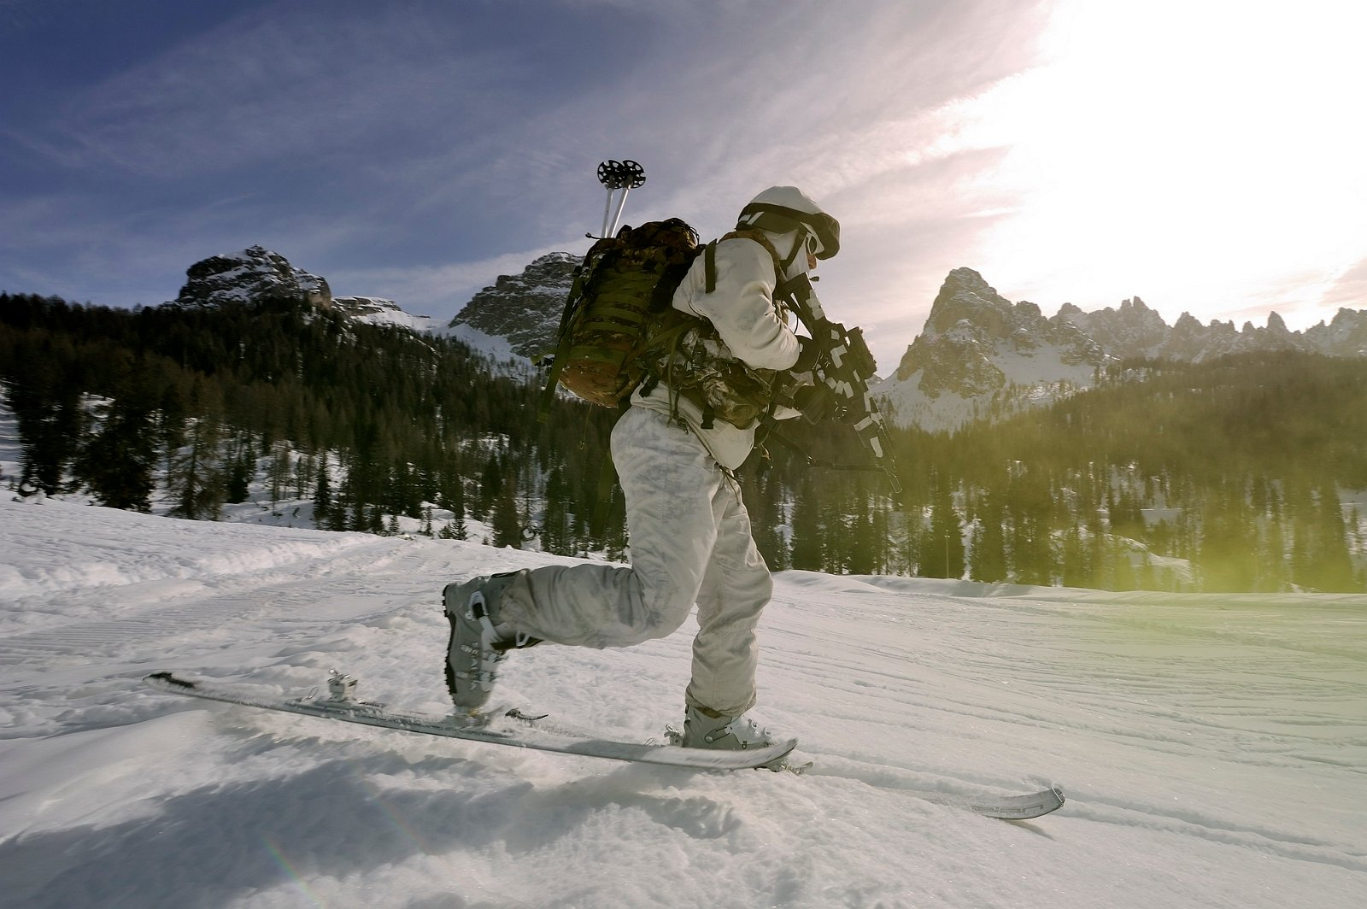
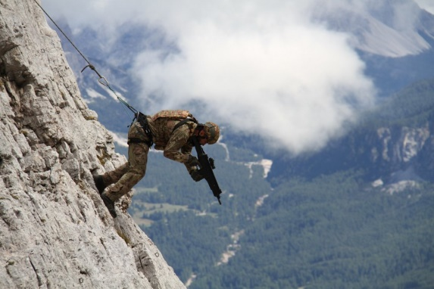
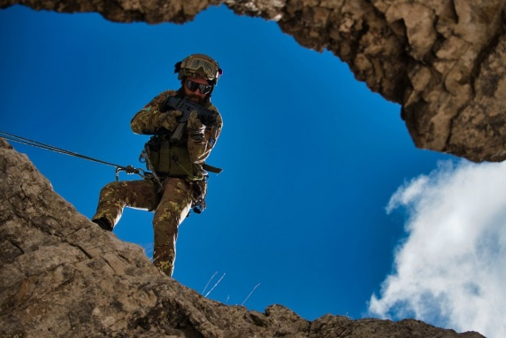
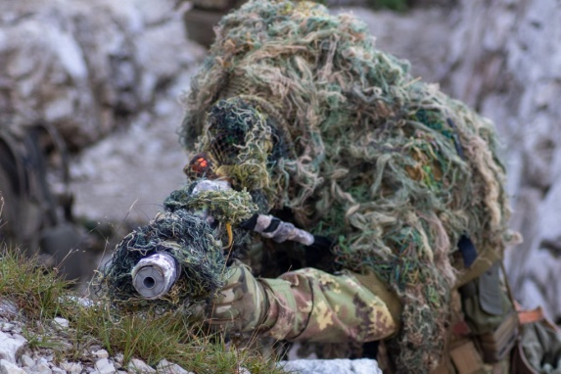
Mountain troops Headquarters General Staff – Doctrine and Training Branch
ANNUAL PLAN
COURSES & EXERCISE
OF-4 Carmelo PEZZINO

Slide 2
COURSES ANNUAL PLAN
& EXERCISE
 | JAN | FEB | MAR | APR | MAY | JUN | JUL | SEP | OCT | NOV | DEC
WINTER SKILLS | BASIC SKI COURSE | ADVANCED SKI COURSE | EXPERT SKI COURSE
 |  | BASIC MW WINTER COURSE | BASIC MW WINTER COURSE |  |  |  |  | MW ADVANCED COURSE
 |  | EXE WHITE FOX
SUMMER SKILLS |  |  |  |  | BASIC CLIMB COURSE | ADVANCED CLIMB COURSE | EXPERT CLIMB COURSE | BASIC CLIMB COURSE | ADVANCED CLIMB COURSE
 |  |  |  |  | BASIC MW SUMMER COURSE | BASIC MW SUMMER COURSE |  | MW ADVANCED COURSE | BASIC MW SUMMER COURSE
 |  |  |  |  | FIREX MORTAR/ARTY Rgt lvl |  |  | EXE ALPINE STAR | LIVEX SNIPER FIREX MORTAR/ARTY Rgt lvl
MOUNTAIN RESCUE |  |  |  |  |  | ALPINE RESCUE OPERATOR COURSE |  |  | ALPINE RESCUE OPERATOR/TECNITIAN COURSE
COMBAT WEATHER | SNOW OBSERVER COURSE | SNOW EXPERT COURSE | FORECAST COURSE

Slide 3
TRAINING LINES AND LEVELS
BASIC
ADVANCED
EXPERT
TECHNICAL TACTICAL
*Requirement
MOVE
WIN
Ski BAS.
Ski ADV.
* Ski Bas. ≥ 15/20
Ski EXP.
Ski adv. ≥ 15/20
Climb. Bas. ≥ 15/20
SUM
Climb BAS.
Climb ADV.
* Climb. Bas. ≥ 15/20
Climb EXP.
* Climb. adv. ≥ 15/20
*Requirement
MW-INDIVIDUAL BASIC SKILL (IBS)
FIGHT
SURVIVE
LEAD
WINTER.
MW ADV.
* IBS(W.) & IBS(S.) ≥ 15/20
*Ski & Climb. Bas. ≥ 15/20
SUMMER
* Climb. Bas. ≥ 15/20
*Requirement
TECHNICAL SPECIALISTIC
MOUNTAIN RESCUE
Operator
* Ski Adv. ≥ 13/20 & Climb. Adv ≥ 13/20
Technician
*Ski Exp.+ Climb. Exp. + Combat Weather Exp. & MR Operator
*Requirement
COMBAT WEATHER
Observer
* Ski Adv. ≥ 15/20
Expert
* Observer & Ski Exp
Forecast
* Exp. ≥ 3 years
RESPONSABILITY LEVEL.
MTTC
From MTTC to BDE lvl.
From MTTC to RGt lvl.
BASIC
ADVANCED
EXPERT
Notes:
3

Slide 4
NAME OF COURSE | SKI BASIC
TRAINING SEASON | WINTER
TRAINING OBJECTIVE | acquire basic skills to use and move easily and safely by using military winter equipment on snowy terrain on and off ski slope with (prepared) ski (downhill and ski mountaineering) and snowshoeing acquire basic knoeledge about snow and avalanches; acquire basic concept about self-rescue and emergency rescue acquire basic capability to survive in winter extreme condition and set-up a refuge with snow
DURATION | 3 WEEKs
SKILL REQUIRED | Fisical fit
CERTIFICATION
TARGET AUD. | Officer, NCOs, Volunteers
BACK

Slide 5
NAME OF COURSE | SKI ADV.
TRAINING SEASON | WINTER
TRAINING OBJECTIVE | Improve skills and technique (ski and ski mountaineering) Improve capability to use military ski equipment, self-rescue and emergency rescue Acquire capabilty to condact a units in mountain winter terrain Acquire capability to support ski instructor during training activities (who acquire certification of SKILLED SKIER)
DURATION | 4 WEEKs
SKILLs REQUIRED | HAVE PASSED BASIC COURSE WITH EVALUATION ≥ 15/20 AND PASS INITIAL SELECTION
CERTIFICATION | WITH EVALUATION ≥ 13/20 SKILLED SKIER
TARGET AUD. | Officer, NCOs, Volunteers
BACK

Slide 6
NAME OF COURSE | SKI EXP.
TRAINING SEASON | WINTER
TRAINING OBJECTIVE | Improve skills and technique (ski and ski mountaineering) IOT become Military Instructor Acquire teaching skilss Improve capabilty to condact a units in mountain winter terrain Improve capability to use military ski equipment, self-rescue and emergency rescue Acquire knowledge about responsibility and liability related to Instructor Qualification
DURATION | 4 WEEKs
SKILLs REQUIRED | HAVE PASSED SKI ADV AND BASIC CLIMB COURSEs WITH EVALUATION 15 ≥ 20 AND PASS INITIAL SELECTION
CERTIFICATION | WITH EVALUATION ≥16/20 TO 17.99/20 SKI MILITARY INSTRUCTOR WITH EVALUATION ≥18/20 TO 20/20 SKILLED SKI MILITARY INSTRUCTOR
TARGET AUD. | Officer, NCOs, Volunteers
BACK

Slide 7
NAME OF COURSE | CLIMB BASIC
TRAINING SEASON | SUMMER - AUTUMN
TRAINING OBJECTIVE | acquire basic skills to use and move easily and safely by using military mountaineering equipment acquire basic climb skilss acquire capability to move on mountain and cross equipped sector with vertical obstacle
DURATION | 3 WEEKs
SKILL REQUIRED | Fisical fit
CERTIFICATION
TARGET AUD. | Officer, NCOs, Volunteers
BACK

Slide 8
BILATERAL CO-OPERATION YEAR 2022 - 2023
NATION | REQUEST | ALLOCATION
NETHERLANDS | 10 Position for Basic Climb. COURSE | We try to allocate 5 position in MAY-JUN 2023 Session Course and 5 position in AUG.-SEP. 2023 Session Course

Slide 9
BILATERAL CO-OPERATION YEAR 2023 – 2024*
NATION | REQUEST | ALLOCATION
SPAIN | 1 Position for ADV. Climb. COURSE | allocated but needs to pass the entry test
 | 1 Position for
 | 1 Position for Combat Weather Exp.
HUNGARY | 2 Position for Basic SKI COURSE
SWEDEN | ROAD MAP for CO-OPERATION
* STILL NEED TO BE APPROVED

Slide 10
Mountain troops Headquarters General Staff – Doctrine and Training Branch
ITALIAN MOUNTAIN TROOPS
EXERCISE SERIES
OF-4 Carmelo PEZZINO

Slide 11
VOLPE BIANCA 22
"White Fox"
OF-4 Carmelo PEZZINO

Slide 12
EXERCISE STRUCTURE
EX VOLPE BIANCA
ICE CHALLENGE
(competition)
ICE PATROL
(competition)
VOLPE BIANCA
STEEL BLIZZARD
WINTER RESOLVE
(FTX)
WINTER STRIKE (STX)
WINTER RESCUE
STX = situation training exercise
FTX = field training exercise

Slide 13
ICE PATROL
EXERCISE OBJECTIVE
Move on severe mountainous environment exploiting Mountain Warfare techniques achieved during training courses to Engage opposing forces
General Data
PTA/strength: Alpini regiments (squad. Level) , Scuola di Applicazione, 2nd signal rgt. (15/16 patrols 120/132 u. plus reserve and RLS)
Ex type: FTX - Competition
OSE: COMTA
OCE :COMTA
ODE: COMTA
TRAINING OBJECTIVE
TASK: | Conduct combined enabling and offensive tasks/activities (infiltrate, link-up, march, patrol, movement to contact, hasty attack, exfiltrate)
CONDITION | Winter season /severe environment Avalanches risk with assesment provided by experts Moutainous, up-hill, down-hill direction Night/day (48h) Individual gear (skis/snowshoes) Individual tactical eq
STANDARD | Circ. 7048, Circ. 13/A/1, NATO ATP 6
ICE PATROL
.

Slide 14
ICE CHALLENGE
General Data
EXERCISE OBJECTIVE
Move on winter mountainous terrain up-hill and down-hill and engage static targets
PTA/strength: Alpini regiments, Scuola di Applicazione, 2nd signal rgt. (2/3 soldiers for each unit)
Ex type: FTX - Competition
OSE: COMTA
ODE : ITA Mountain Training Centre
OCE: ITA Mountain Training Centre
ICE CHALLENGE
.

Slide 15
STEEL BLIZZARD
WINTER RESOLVE
General Data
EXERCISE OBJECTIVES
Conduct Coy(+) level, multinational combined arms operations, executing multiple Tactical Activities within a winter mountainous environment for deterrence purposes improving interoperability among NATO Forces.
PTA/strength: Alpine COY (combined arms, enablers cross-domain ops), scout 173rd USA , AB(200 u./approx.)
Date: feb - mar
Ex type: FTX
OSE: COMTA
WINTER RESOLVE
OCE: RGT CDR
ODE: BN CDR

Slide 16
STEEL BLIZZARD
WINTER STRIKE
General Data
PTA/strength: Alpine COY (combined arms, enablers cross-domain ops), 200 u.
Date: FEB - MAR
Ex type: STX
OSE: COMTA
ODE: RGT CDR
OCE: BN CDR
EXERCISE OBJECTIVE
Plan and perform attack to enemy HVTs.
WINTER STRIKE

Slide 17
WINTER RESCUE
EXERCISE OBJECTIVE
Perform mountain search & rescue team activities within a severe winter environment in partnership with civilian rescue/relief agencies.
General Data
PTA/strength: Brigade Alpine Rescue Teams + CNSAS teams 50 u.
Exe type: FTX
OSE: COMTE
ODE: Brigade HQ
OCE: Brigade HQ
WINTER RESCUE

Slide 18
GENERALITIES
EXERCISE NAME: Volpe Bianca
OBJECTIVE: Evaluate the preparation achievied by the Units in performing tasks typical of offensive operations and combat search and rescue within a winter mountainous environment.
CONSTRAINTS:
Execution of specific preparatory training and technical courses
environmental concerns for training areas
Availability of Military e Civilian accommodation

Slide 19
EXERCISE Volpe Bianca 2022
LOCATION: Alto Adige – Veneto (Arabba)
PERIOD: 28 feb. – 11 mar. 2022
DV day: 9 mar. 2022
AIM: Evaluate the preparation achievied by the Units in performing tasks typical of offensive operations and combat search and rescue within a winter complex mountainous environment characterized by extreme challenging weather conditions a natural obstacles, increasing the specialistic capability of the involved units (both at individual and collectie level) with focus on «mobility» and «C2».
THEME: «Alpini» units conducting offensive, defensive and enabling tachtical activities in mountainous environment in a joint, combined and cross-domain context.
TYPE/FORM: LIVEX/FTX/CPX/STX
OSE:
White Fox: COMTA
OCE:
Overall: COMTA (DCOM);
Winter Rescue: B. HQ
Ice Patrol: COMTA
Ice Challenge: Mountain Troops Training Centre (MTTC)
Steel Blizzard: RGT lvl.
ODE:
Ice Patrol: COMTA
Ice Challenge: Mountain
Troops Training Centre 8
MTTC)
Steel Blizzard: BN Lvl.
Winter Rescue: Brigade HQ
PARTECIPANTS:
ITA: about 650 un., Army Aviation helos, n. 1 SF pl. (mountain paratroopers), Task Force Info. Tat. (Electronic Warfare (EW) and battlefield survey assets), V-SHORAD assets and Aviation assets.
USA: n. 1 pl. 173rd AB Brigade
FRA: n. 1 pl (-) 27^ BIM

Slide 20
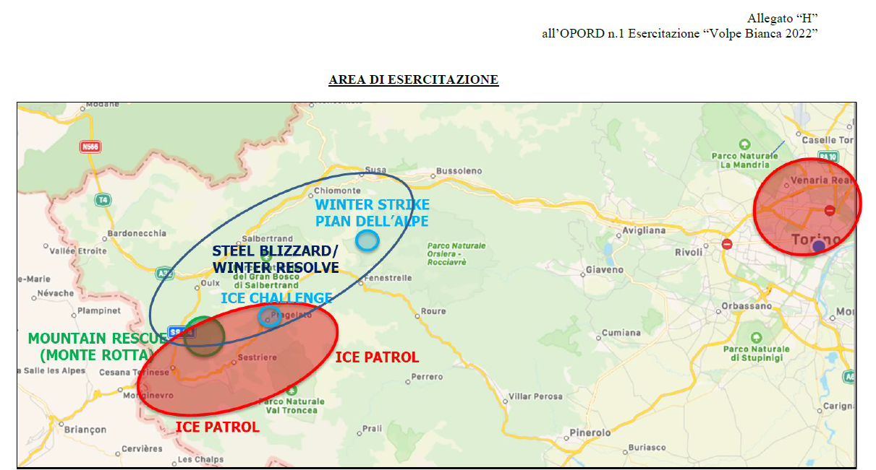
AREA of EXERCISE

Slide 21
TIMELINE
PREPARATION TRAINING
EXECUTION
NOV
DEC
JAN
FEB
MAR
BASIC SKI COURSE (BAJ)
MOUNTAIN WARFARE COURSES (160 u.)
ICE PATROL 7-11
BASIC SKI COURSE (TAU)
STEEL BLIZZARD
COLLECTIVE TRAINING
WINTER RESOLVE 28 Feb-4 Mar
WINTER STRIKE
(1 day)
TAU BDE COMMEX 14 Dec
Ski course 173rd
WINTER RESCUE
(1 day)
Volpe Bianca2022
28 Feb-11 Mar

Slide 22
ADDITIONAL INFROMATION
Participation of partner and Allied countries in 2023-2024 is allowed both to tactical exercise (Steel Blizzard) and competitions (Ice Challenge – Ice Patrol)
High physical fitness and basic skills in Mountain Warfare are required
Accommodation and meals in military facilities (details to be defined)

Slide 23
ALPINE STAR 22
OF-4 Carmelo PEZZINO

Slide 24
EXERCISE STRUCTURE
EX ALPINE STRAR
EXTREME PATROL
(competition)
EXTREME CHALLENGE
(competition)
ALPINE STAR
STEEL BLIZZARD
SUMMER RESOLVE
(FTX)
VERTIGO
(STX)
STX = situation training exercise
FTX = field training exercise

Slide 25
EXTREME PATROL
AIM: verify capability to conduct combat patrol in a mountainous environment (Mountain Warfare)
LOCATION: Renon, Bolzano.
PERIOD: 20-22 sep.
TYPE: STX in the form of a «lane training» with obstacles and exercises
PTA: Patrol (8 personnel) per each IT Mountain Troops Combat/Combat Support Bn. (NO Combat Service Support units)
OSE: IT Mountain Troops HQ
OCE: IT Mountain Troops Training Center
ODE: 6° Alpini Bn.
ALPINE STAR
EXTREME PATROL

Slide 26
EXTREME CHALLENGE
AIM: verify personnel capability to move through a complex mountainous terrain including a «Spartan Race»-like path.
LOCATION: Renon, Bolzano
PERIOD: 24 sep.
TYPE: competition
PTA: n.4 personnel per each IT Mountain Troops Bn.
OSE: IT Mountain Troops HQ
OCE: IT Mountain Troops Training Center
ODE: 6° alpini Bn.
ALPINE STAR
EXTREME CHALLENGE

Slide 27
SUMMER RESOLVE (FTX)
AIM: Verify IT Mountain Troops Units/personnel operational readiness and training level in planning and conducting offensive and defensive activities at tactical level in a complex mountainous environment
LOCATION: Pusteria Valley (Dolomites, northeastern Italy )
PERIOD: 3-7 Oct.
TYPE:FTX
PTA: Mountain Troops infantry Bn-level unit («Alpini»), 173rd US Army Bde pl. level unit, 27th FRA Mountain Troops Bde pl. level unit, IT Army Aviation rotary wing, IT/US Aviation fix wing
OSE: COMTA
OCE: Brigade HQ
ODE: Bn lvl.
ALPINE STAR
SUMMER RESOLVE FTX

Slide 28
VERTIGO (STX)
AIM: demonstrate and verify IT Mountain Troops Units capability to conduct warfighting and S&R activities in mountainous environment characterized by a significant vertical development by applying Mountain Warfare techniques.
LOCATION: MERANO 2000 SKI AREA
PERIOD: 04 Oct.
TYPE: STX
PTA: Mountain Troops infantry coy-level unit («Alpini»), Mountain Troops recce platoons («Alpieri pl.), Military Mountain Rescue Squads, 173rd US Army Bde personnel, IT Army Aviation rotary wing, IT/US Aviation fix wing
OSE: COMTA
OCE: RGT lvl.
ODE: BN lvl.
ALPINE STAR
VERTIGO STX

Slide 29
EXERCISE STRUCTURE ALPINE STAR 2022
ALPINE STAR

Slide 30
EXERCISE STRUCTURE ALPINE STAR 2022
- EXTREME CHALLENGE/EXTREME PATROL -
CTE AOSTA
EXTREME CHALLENGE
EXTREME PATROL
LNO
CTE
6° RGT ALP
EXTREME CHALLENGE
EXTREME PATROL
RLS
NUCLEO C2
ISTRUTTORI MW
S1/S8
SALA OPV
S4
MOVIERI
OPFOR
SANITA’
GIUDICI
OCT
SSAM

Slide 31
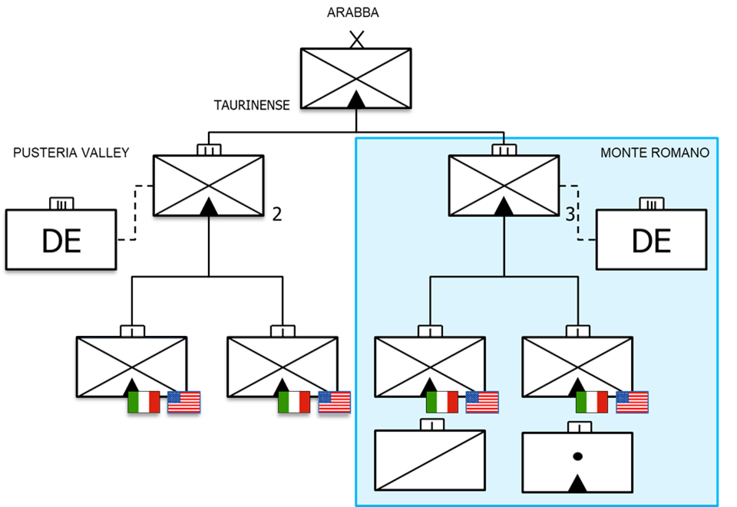
EXERCISE STRUCTURE ALPINE STAR 2022 - SUMMER RESOLVE -
SUMMER RESOLVE
SUMMER RESOLVE
MONTE ROMANO 2/22

Slide 32
EXERCISE STRUCTURE ALPINE STAR 2022 - VERTIGO -
S1
TG (8° Alp.)
S2
S3
FSE
S4
SSAM
MMT
U
A COY
(3°)
S6
TACP
Military Mountain Troops
Rescue Squad
A
(2°)
VERTIGO
SAR
(2°)
SPT MAN
LEGENDA
TACOM
TACON

Slide 33
EXERCISE ALPINE STAR 2022
LOCATION: Alto Adige – Veneto (Arabba)
PERIOD: 19 set. – 7 ott. 2022
DV day: 4 ott. 2022
AIM: verify the readiness of Mountain Troops and their capability to plan and conduct warfighting activities in complex mountainous environment characterized by relevant vertical development in a slightly permissive scenario, pursuing an increased of interoperability with foreing units mainly trough the partnership with 173rd US AB Bde. IOT promote a common approach to Mountain Warfare.
THEME: «Alpini» units conducting offensive, defensive and enabling tachtical activities in mountainous environment in a joint, combined and cross-domain context
TYPE/FORM: LIVEX/FTX/CPX/STX
OSE:
Alpine Star: COMTA
Mte Romano 2/22: B. Taurinense
OCE:
Overall: COMTA (DCOM);
Summer Resolve: Brigade HQ
Extreme Patrol: (MTTC)
Extreme Challenge: (MTTC)
Vertigo: COMTA (DCOM)
Summer Resolve: RGT lvl.
ODE:
Extreme Patrol: (MTTC) Extreme Challenge: (MTTC) Vertigo: BN lvl.
Summer Resolve : RGT lvl.
PARTECIPANTS:
ITA: about 1400 un., Army Aviation helos, n. 1 SF pl. (mountain paratroopers), Task Force Info. Tat. (Electronic Warfare (EW) and battlefield survey assets), V-SHORAD assets and Aviation assets (TBC).
USA: 50 un. (173rd AB Brigade)
Observers: Tunisia, Svizzera, Malta, Regno Unito (TBC), Austria (TBC).

Slide 34
AREAs of EXERCISE
VERTIGO
VIPITENO
SUMMER RESOLVE
BRUNICO
SAN CANDIDO
MERANO
BRESSANONE
ARABBA
ALPINE STAR
RENON
EXTREME PATROL
BOLZANO
EXTREME CHALLENGE
DIREX
North Italy
Center Italy
MONTE ROMANO

Slide 35
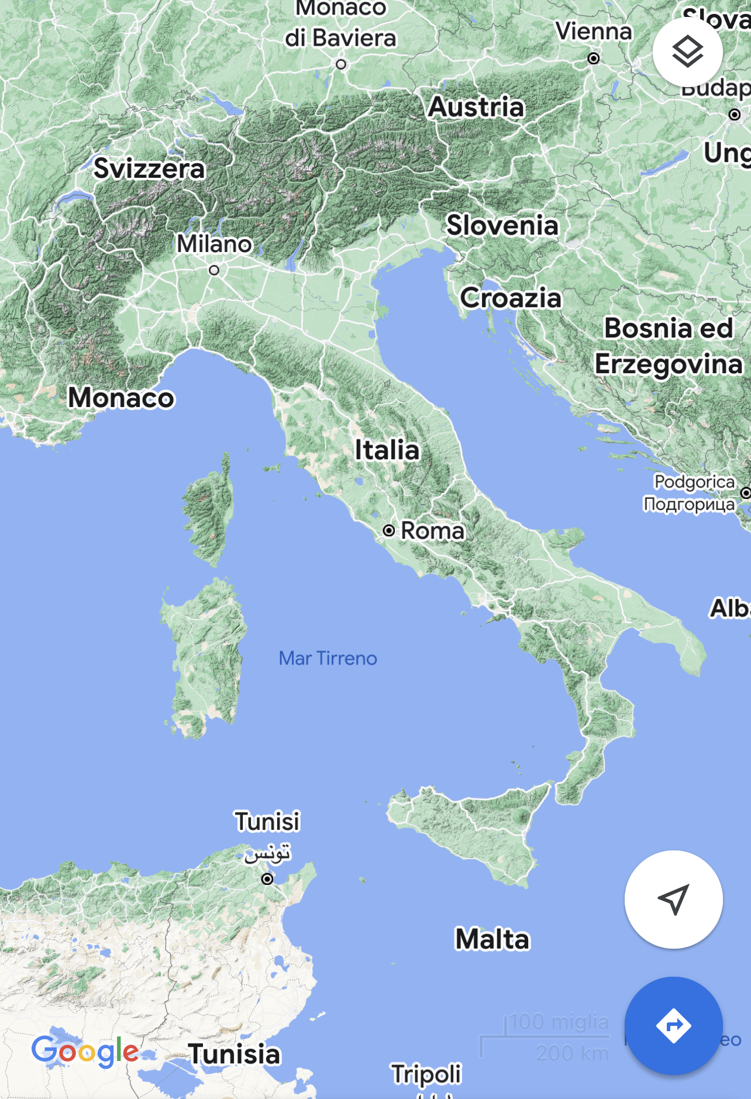
AREAs of EXERCISE
SUMMER RESOLVE
VERTIGO
EXTREME PATROL – EXTREME CHALLENGE
ALPINE STAR

Slide 36
ADDITIONAL INFORMATION
Participation of partner and Allied countries in 2023-2024 is allowed both to tactical exercise (Summer Resolve - Vertigo) and competitions (Extreme Challenge – Extreme Patrol)
High physical fitness and basic skills in Mountain Warfare are required
Accomodation and meals in military facilities (details to be defined)

Slide 37
Mountain troops Headquarters General Staff – Doctrine and Training Branch
ITALIAN MOUNTAIN TROOPs
POC: for Courses, Training, Exercise OF-4 Carmelo PEZZINO email casezadd@comalp.esercito.difesa.it
OF-4 Carmelo PEZZINO

