Slide 1
8th PCM & 2022 Annual Conference 18 – 21 October 2021 PAMPLONA, SPAIN

Slide 2
EDELWEISS RAID
World Cup for Mountain Soldiers
the most demanding competition on squad level

Slide 3
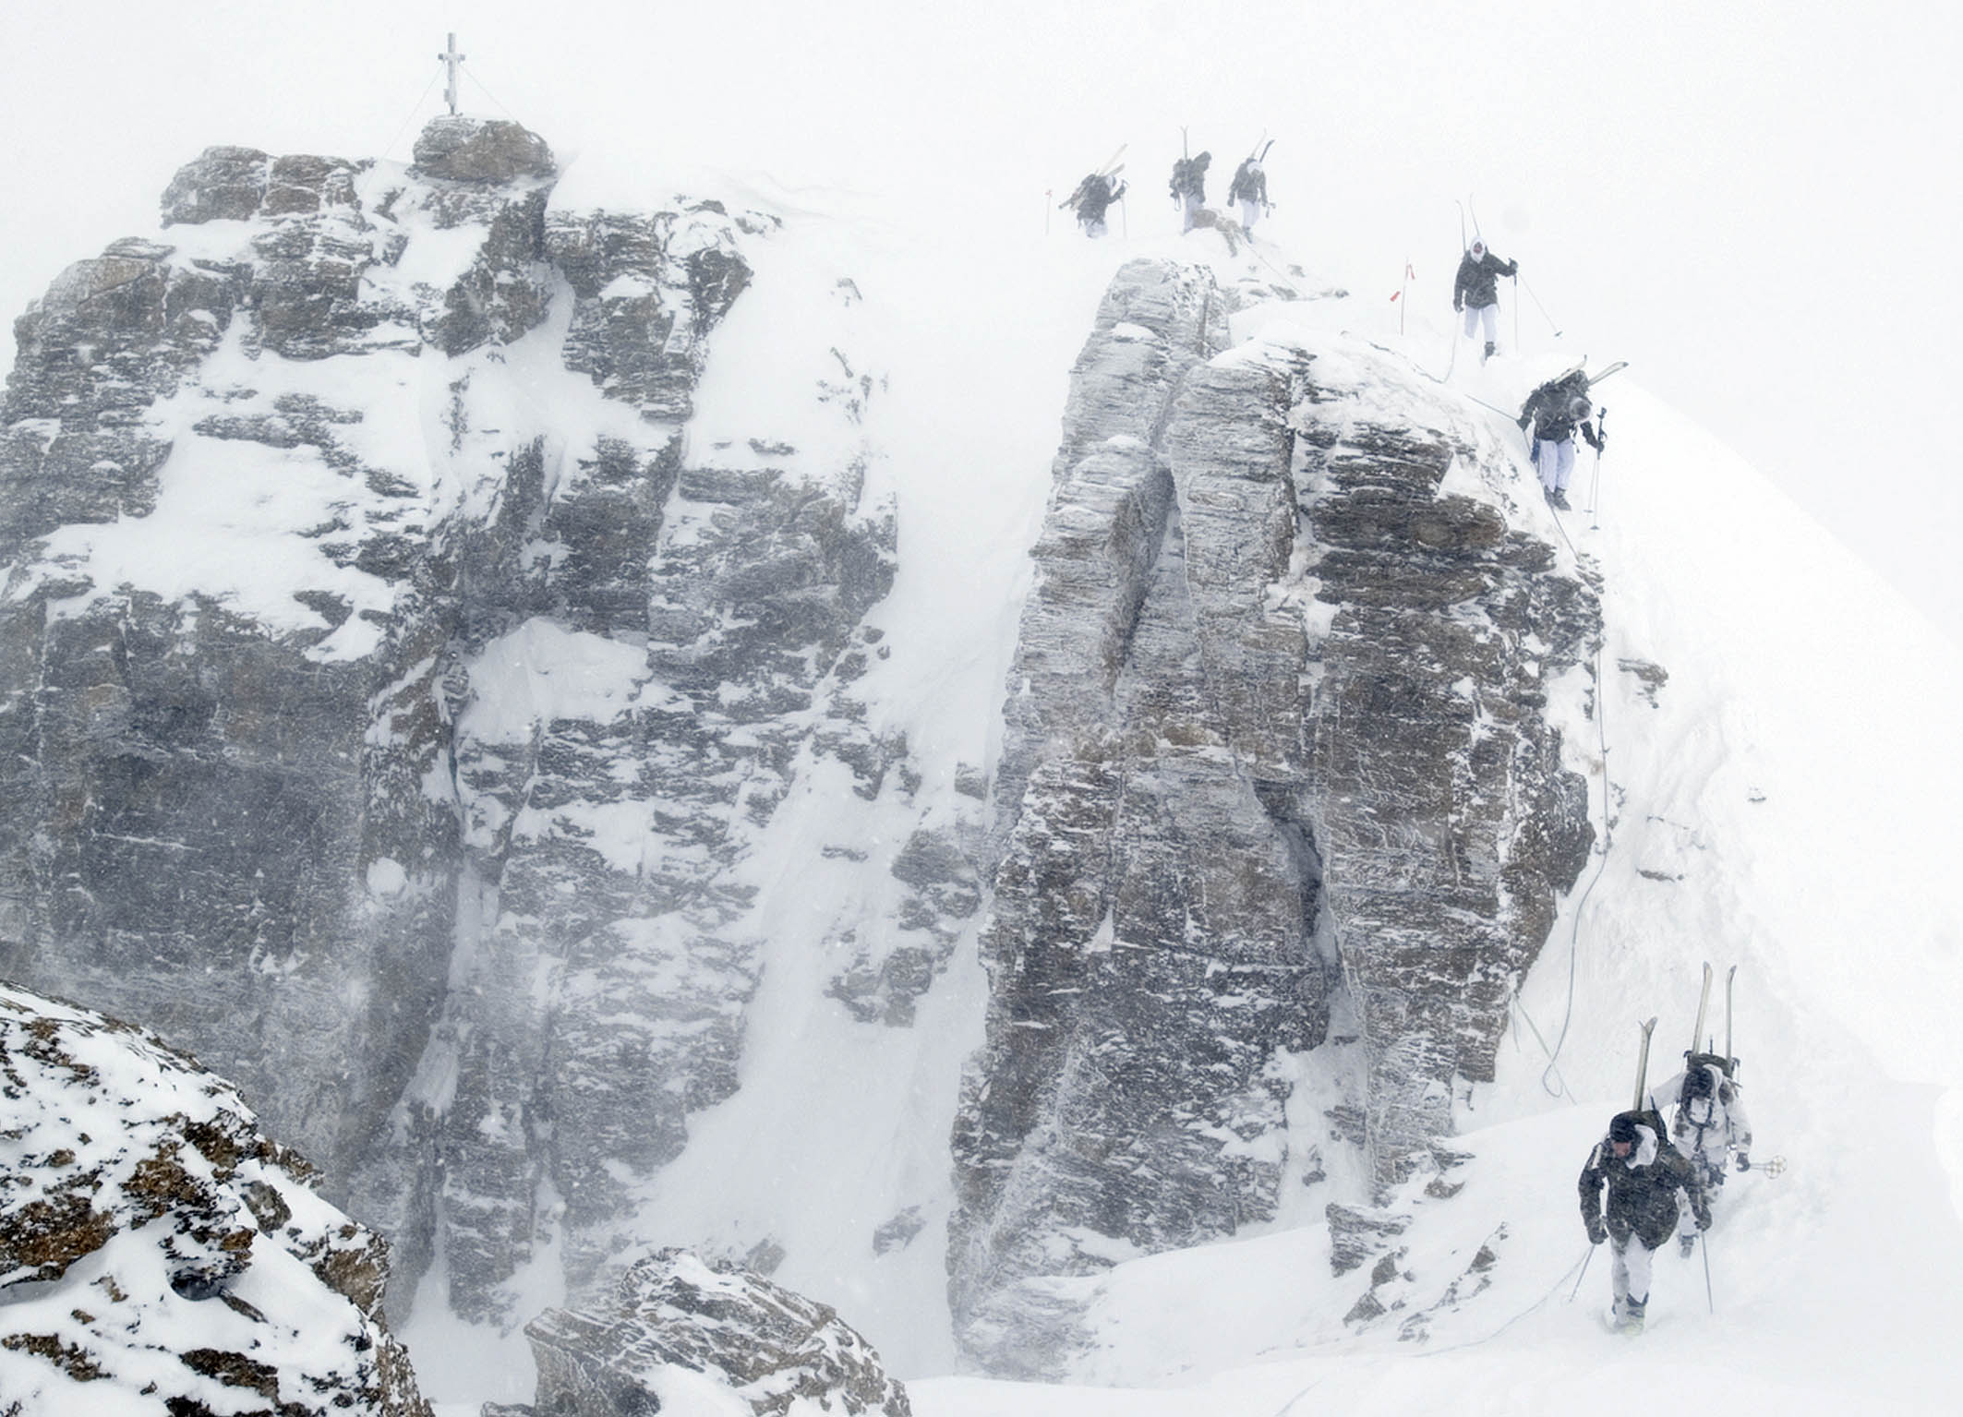
8 personnel
2 days
40 km distance
4000 m ascent
12 additional military tasks
Alalanche search
Shooting
Abseiling
Skiing as roped party
Mountain rescue
Reconnaissance
Sledge pulling
Bivouacing
Transport of insured comrade
March planning
Orienteering
Throwing hand grenades
Participating nations:
AUT BEL BGR CHE CZE DEU ESP FRA ISR ITA NLD ISR ROU RUS POL SLO USA

Slide 4
Finisher‘s Reward:

Slide 5
