Slide 1
8th PCM & 2022 Annual Conference
18 – 21 October 2021
PAMPLONA, SPAIN

Slide 2
Update 2022 Annual Conference ESP
19 Oct 22
ALPINE DEFENCE 2024
LFX & FTX Joint Fire Support

Slide 3
Agenda
General Information
Exercise Aim
Training Objectives
Scenario
Timeline
Q&A

Slide 4
AD-24 - General Information
Name | ALPINE DEFENCE 2024 (AD-24)
Form / Type | INVITEX / FTX / LFX
Participants | TBD / TBC (invitation during 7th PCM (VTC)) JFST as PTA 1 mortar platoon Aircrafts (FW, RW) Staff personnel, observers, controllers ….
Date | 2 weeks within CW 38-41
Training Area | LFX - MTA HOCHFILZEN & RAMSAU/MOLLN & SEETALER ALPE FTX – province of Tyrol IVO HOCHFILZEN – outside MTA
OSE, OCE and EXDIR | TBD
Host Nation | AUT
Accommodation | Military barracks

Slide 5
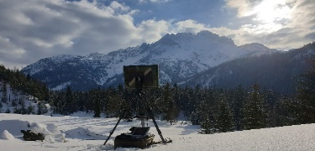
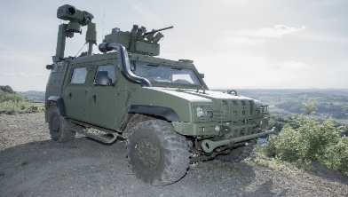
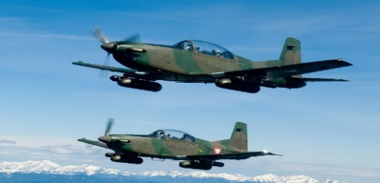
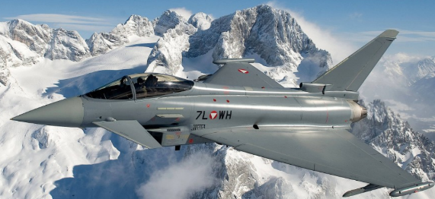
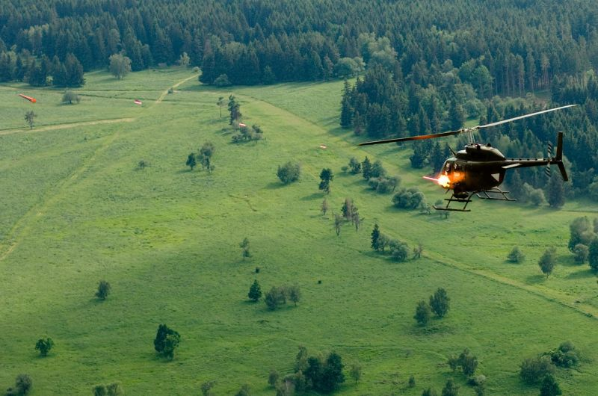
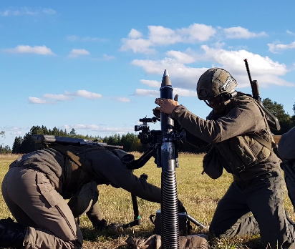
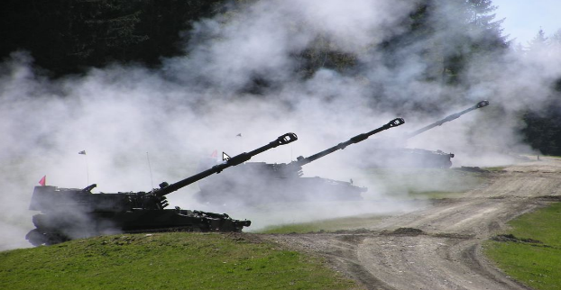
AD-24 - participants
AUT
  2 JFST – Primary Training Audience
  Mtr-Platoon, Arty
  FW (Typhoon, PC-7, PC-6), RW (KIOWA)
MTI-participants
  6 JFST - PTA
  IDF – 1 Mtr-Platoon
  FW (any type of – slow/fast mover), RW (attack helo, transport helo, Rescue helo)
  Staff personnel, observer, controller …

Slide 6
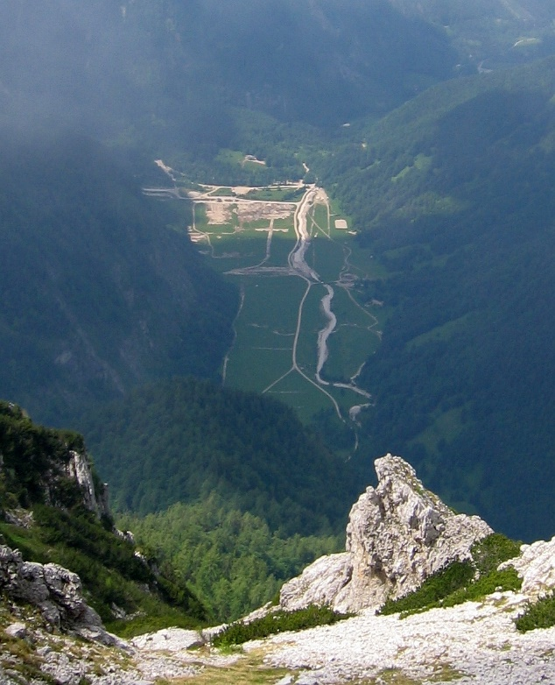
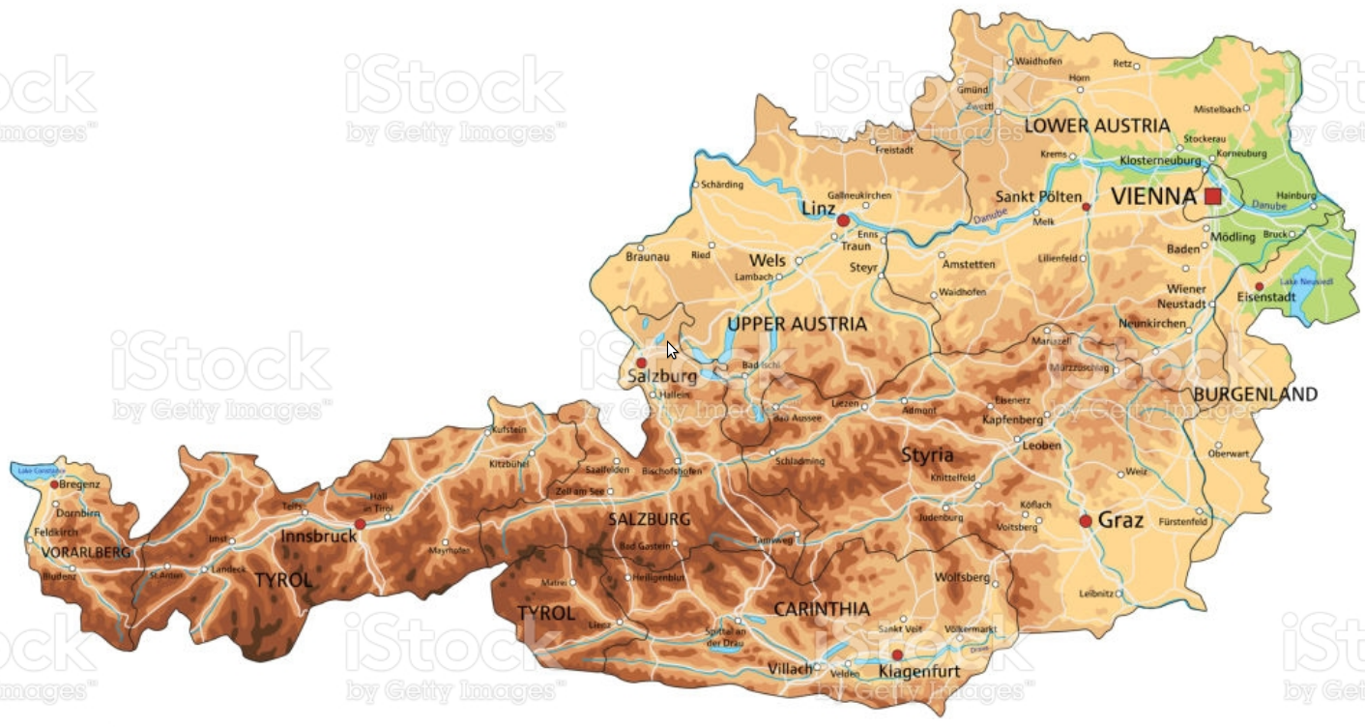
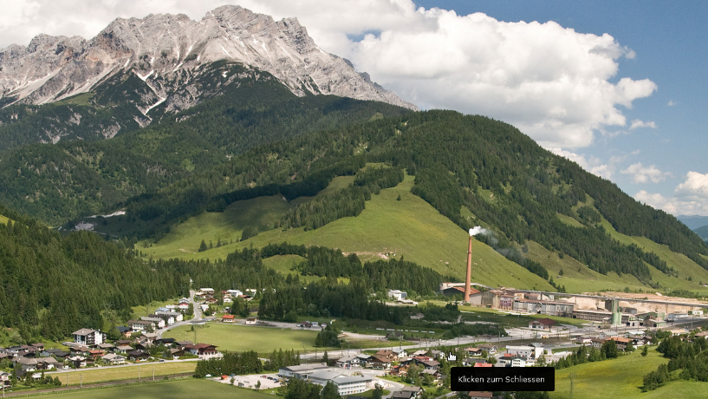
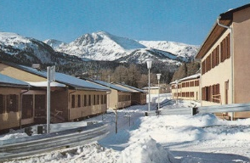
AD-24 - LFX Areas Air to Ground
MTA RAMSAU/ MOLLN
MTA HOCHFILZEN
MTA SEETALERALPE

Slide 7
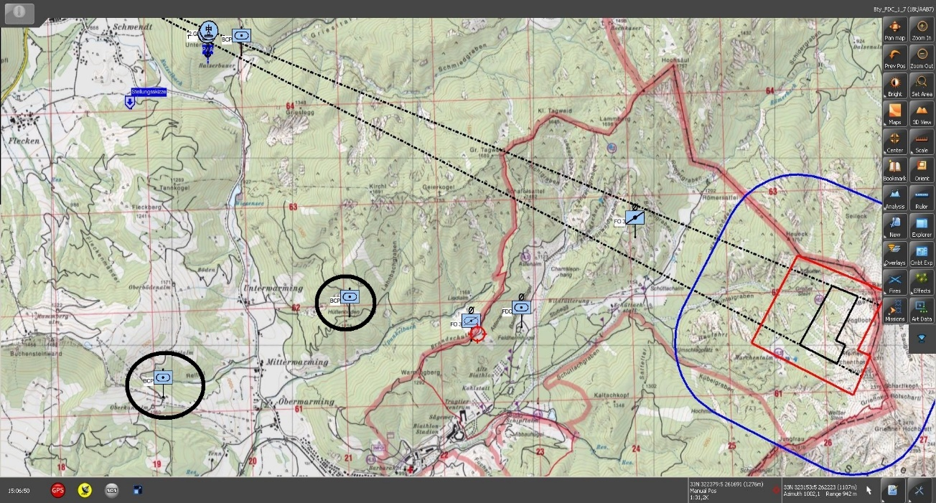
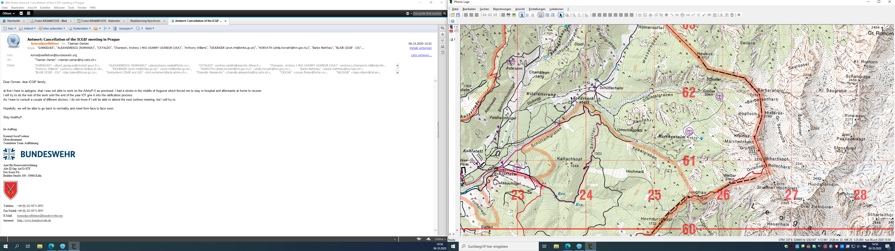
AD-24 - LFX Area IDF
MTA HOCHFILZEN
PAA
TAI_ALPHA:
IDF + CAS
FO
TAI_MIKE:
IF+ CAS
FO
FSCT
TAI_Arty
TAI_MTR
TAI_CAS
1 PAA/Arty (outside) → TAI MIKE
2 PAA/MTR → TAI ALPHA + MIKE
2 Base-positions KIOWA → MIKE

Slide 8
AD-24 - FTX Area
MTA HOCHFILZEN

Slide 9
Exercise Aim
fire support operations at Combined Joint Operations Level allowing JFST to train in a demanding high mountain environment as Primary Training Audience
  Life firing Joint Fire during a LFX – 2 JFST per day
  Conduct Dry Runs and CFF during a FTX day and night

Slide 10
AD-24 – Training Objectives
Introduction of Sensors
  Sensors 1 Ground Surveillance Radar „Beagle“
  Sensors 2 BAA EO „Husar“
Call for Fire (CFF)
Observer Training System (OTS)
Theory Mountain Warfare
Occupying an Observation Post (OP)
Mobility in mountainous terrain
  Plan und use various transport means
  March in mountainous terrain
Sustain in mountainous terrain

Slide 11
AD-24 - scenario

Slide 12
AD-24 - scenario

Slide 13
AD-24 - Timeline
Until 15 Dec 22 Develop DRAFT EXSPEC
Until 15 Jan 23 EU MTI-nations‘estimations of participation
  Involving HQs deciding about participation Airforce, MTR-platoon and JFST on basis of MiM
May 23 IPC
4. Qu 23 MPC
2. Qu 24 FCC
2 weeks of Week 38-41 Conduct of AD-24

