Slide 1
8th PCM & 2022 Annual Conference
18 – 21 October 2021
PAMPLONA, SPAIN

Slide 2






Welcome Address
Participants:
AUT
BEL
BGR
CZE²⁾
DEU
ESP³⁾
FRA⁴⁾
HRV
NLD
POL
SVN
SWE¹⁾
Observer:
Permanent Guest:
NATO
MW COE
Guests:
ITA
ROU
¹⁾ since 28th Nov 2016
²⁾ since 6th Dec 2017
³⁾ since 26th Oct 2020
⁴⁾ since 22th Sep 2022

Slide 3
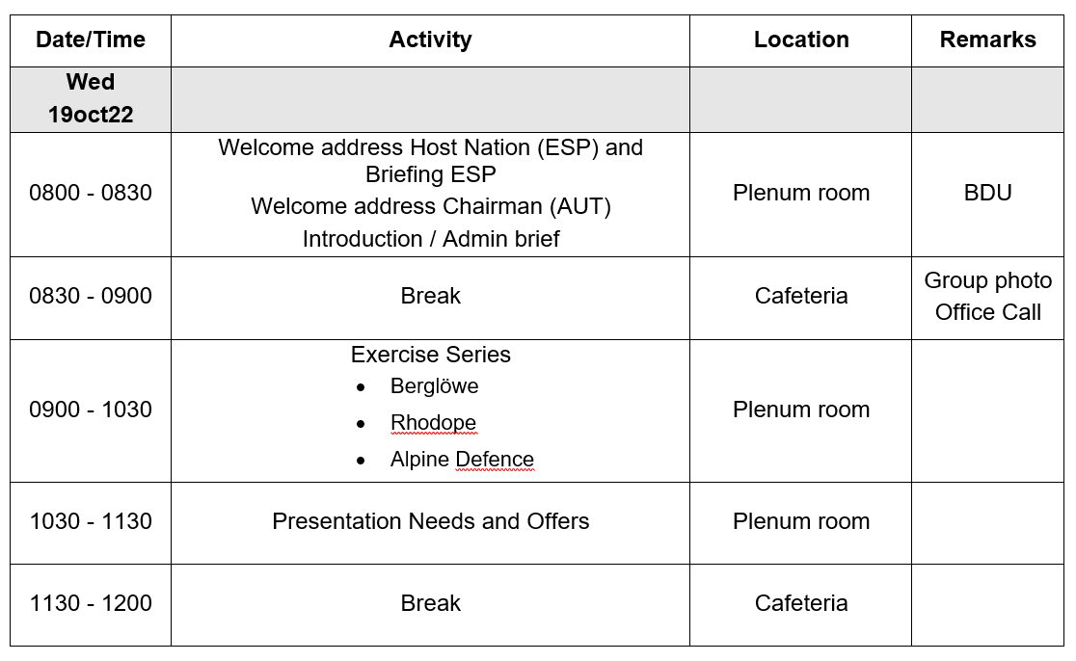
Schedule

Slide 4
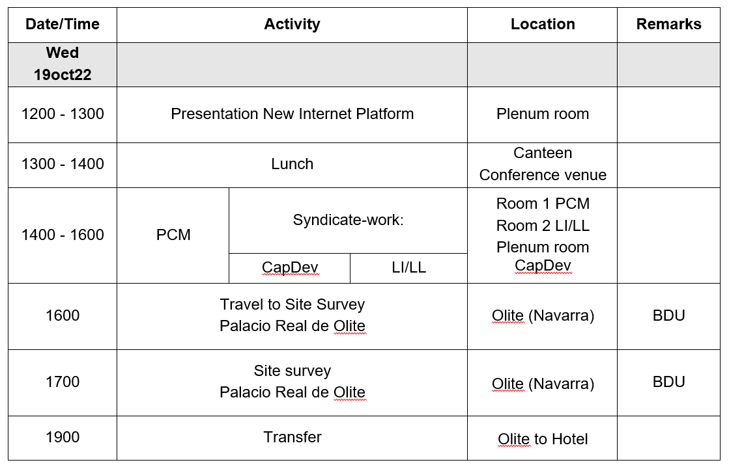
Schedule

Slide 5
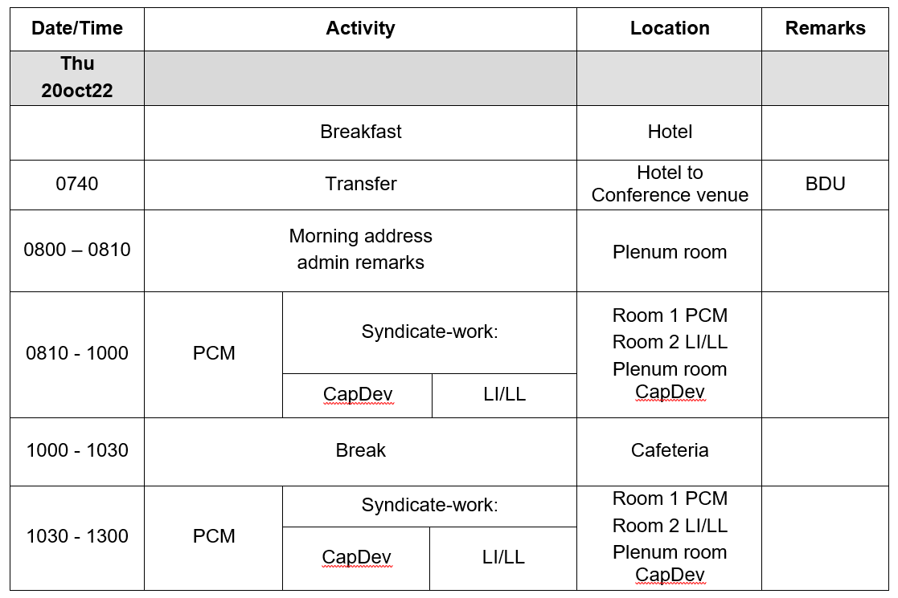
Schedule

Slide 6
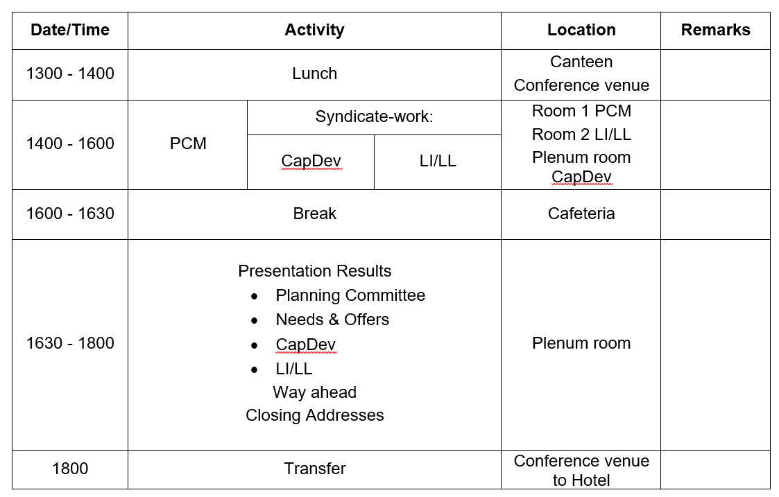
Schedule

Slide 7
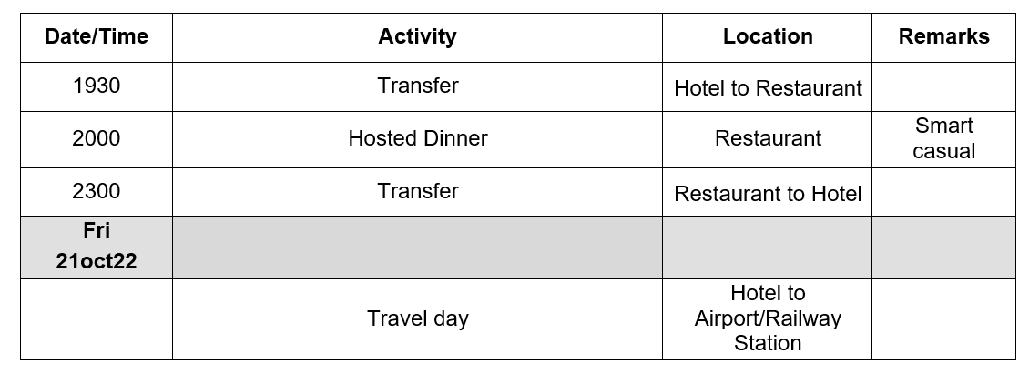
Schedule

Slide 8












Mountain Troops Command
Fuerza Terrestre
División San Marcial
Escuela Militar de Montaña y Operaciones Especiales
Mando de Tropas de Montaña
Jefatura de Adiestramiento y Doctrina de Montaña
Cuartel General
RICZM “Galicia” 64
RICZM “América” 66

Slide 9






Mountain Troops Command
Fuerza Terrestre
División
San Marcial
Mando de Tropas de Montaña
Escuela Militar de Montaña y Operaciones Especiales
Cuartel General
Jefatura de Adiestramiento y Doctrina de Montaña
RICZM “Galicia” 64
RICZM “América” 66
BCZM “Pirineos”
CÍA Esquiadores Escaladores
BCZM “Montejurra”

Slide 10
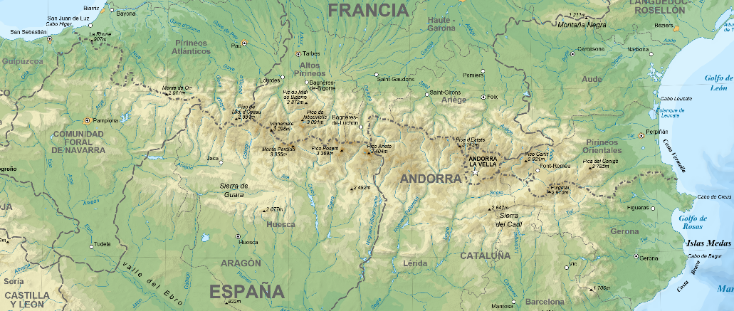
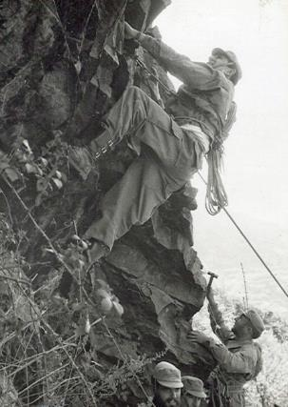
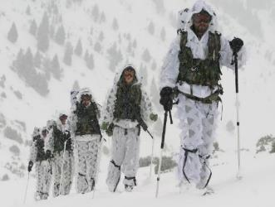
Mountain Troops Command
RICZM 66
Candanchú
Cerler
Collada Tossas
CGMTM
RICZM 64
1899 → Creation
1942 → Enforcement
1945 → EMMOE
1985 → Two Divisions
1995 → Reduction
2017 → Cierre JTM
2021 → Creación MTM

Slide 11
Mountain Troops Command
The Mountain Troops Command is the only unit in the Spanish Army organized, equiped, and trained to provide life, movement and combat capabilities in mountainous terrain and extreme cold weather conditions environment to accomplish any mission which require these capabilities. (Orden DEF/708/2020)
Capabilities
1 Task Force (Battalion size) (Without Support Units) – R: 20 días
1 Task Force Coy Team Climbers-Skiers (-) – R: 10 días

Slide 12
Our Strenghts
Young, trained and ready unit.
High morale and “esprit de corps”.
Unique special capabilities.
Privileged location for our training (Pyrenees).
Multi-scenario suitability.
Leadership School.

Slide 13

Admin. Brieffing

Slide 14
Admin. Brieffing
Different Units in the building
Working place
Movement restricted

Slide 15
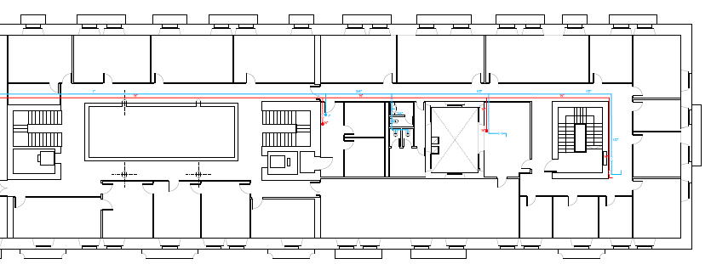
Syndicate Rooms
Plenum
PCM
3rd Floor
PLENUM
PCM

Slide 16
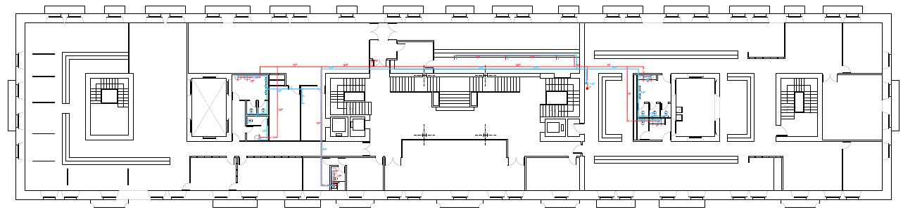
Syndicate Rooms
Syndicate Rooms, Coffe, WC
1st Floor
LI LL
CAP/DEV
COFFE ROOM
WC

Slide 17
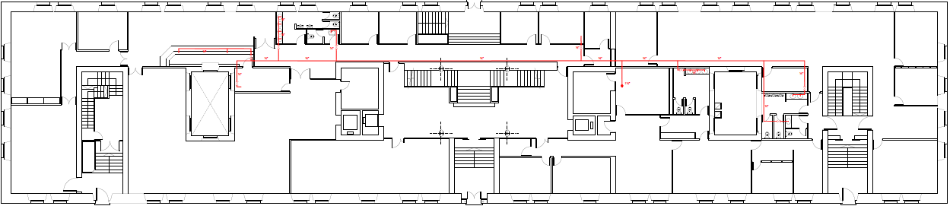
Dinning Hall
Ground Floor
CAP/DEV
WC
DINNING ROOM

Slide 18
Transfers Schedule
Oct 19th
07:40- Hotel to Conference Venue
16:00- Conference Venue to Hotel
Site Survey (Meeting Point for all: Main Acces)
17:00- Hotel to Conference Venue
19:00- Conference Venue to Hotel

Slide 19
Transfers Schedule
Oct 20th
07:40- Hotel to Conference Venue
18:00- Conference Venue to Hotel
Hosted Dinner (Meeting Point for all: Main Acces)
19:30- Hotel BdN to Hotel 3 Reyes to Restaurant
23:00- Restaurant to Hotels

Slide 20
Transfers Schedule
Oct 21st
Transfer to Airport/Train Station. Innitialy:
08:00- Hotel 3 Reyes – Hotel BdN – Airport
10:30- Hotel 3 Reyes – Hotel BdN – Airport
12:00- Hotel 3 Reyes – Hotel BdN – Airport

Slide 21
Needs or Requests
Cpt Serrano
Sgt Francisco

Slide 22
Admin Remarks
Group Photo
Help Desk AUT, 2nd floor

