Slide 1

FTX CAPRICORN 15
Presentator: COL Klaus ZWEIKER
Function: DepBrigCdr
Date: 10 jun 15
Place: Hochfilzen
Notes:
Good afternoon Sirs, gentlemen. May I introduce myself:…
I will give you a briefing about the exercise CAP15, which is currently ongoing and will come to it‘s climax today and tomorrow morning.
After that, I‘ll show you the plans for CAP16, which of course will be even more interesting for you.
This will be the first exercise under the flag of MTI conducted with our international partners and offered to you.
Let me now give a an overview about CAP15.
In case you have any questions for understanding please ask immediately. In case of other questions, please ask at the end of the briefing, when we also can have a short discussion if required.

Slide 2
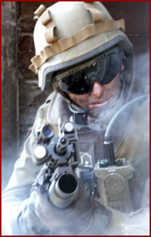
AGENDA
  AIM
  SITUATION
  MISSION
  EXECUTION
Notes:
Gentlemen. I will follow this agenda.

Slide 3
AIM
Train a reinforced Battalion sized Battle Group
  in a field training exercise
  in mountainous terrain
  in a defensive operation
  as part of a stabilisation operation
  embedded in a multinational forces scenario
Notes:
The aim of the exercise this year is to train …

Slide 4
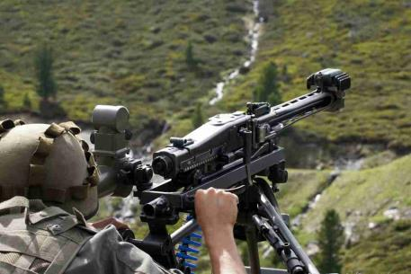
INITIAL SITUATION
Notes:
Now I‘ll give you a short introduction to the Scenario and initial situation for the exercise.

Slide 5
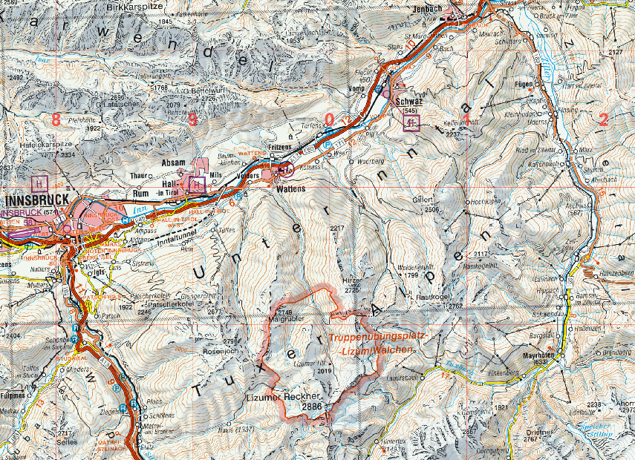

SITUATION OF CONFLICTING PARTIES
Aim of the HNF: occupy refugee camp IOT have a pledge for further negotiations
Lumean Minority (20%)
CP
HSF
Stability OP
CP
HSF
HNF
OBJ „L“
(-)
HIGHLANDERS (Majority, 80%)
Defense OP
HNF
Notes:
Szenario:
The scenario was set up in fictitious country called HIGHLAND. The population there consists of a LUMEAN minority (20%) in the northern part and a majority (80%) of native HIGHLANDERS.
There was a significant increase of nationalism within HIGHLAND Due to economic problems. The majority rioted against ethnic LUMEAN minority. The minority was accused of exploiting the social system and being responsible for the economic deterioration.
The so called “HIGHLAND NATIONAL FRONT (HNF)”, an ultra-nationalist paramilitary organisation started aggressive actions against the minority. After several encroachments on the LUMEAN minority by nationalist HIGHLANDERS the HIGHLAND SECURITY FORCES (HSF) were deployed IOT protect the LUMEAN territory.
However LUMEANS in the HIGHLANDER-dominated regions felt insecure and started to head to the northern parts of HIGHLAND.
UNHCR established a refugee camp (approx. 450 LUMEAN refugees) IVO LIZUMER HÜTTE and the camp is protected by an UN-platoon.
After a UN security council resolution the EU deployed a multinational stabilization force in Highland IOT protect the minority and ensure a safe and secure environment.
After several bomb attacks within LUMEAN settlements the HSF established checkpoints at the main roads towards north IOT prevent further movement of insurgents. But they were not able to avoid infiltration of LUMEAN settlements by HNF-fighters, committing further attacks, kidnapping and acts of violence.
According to intelligence reports the HNF was planning to attack the refugee camp LIZUMER HÜTTE with BN sized troops IOT seize the area as a pledge for further claims.
This lead to a Contingency planning of the EUFOR and as a consequence to a defence operation by a reinforced MINFBN in the LIZUM IOT to protect the IDP.

Slide 6
TASK ORGANISATION
(FRAMEWORK)
MTA
MN
6
24
11
45
AVTF
AUT
AUT
DEU
ITA
AUT
3
AUT
MP
2
AUT
NLD
2
AUT
Notes:
This is the task organisation of the multinational peace force for the stabilisation operation in HIGHLAND as the framework for the main training audience. This is the AUT MINFBN24.

Slide 7
EXERCISE ORGANISATION
6
BLUE Force
OPFOR/ EXCON
(-)
Real Life Support
24
26
6
MP
MOVCON
Stb
(-)
2
26
HNF
ALO
SignBn2
1
24
JFSCT
Refugees,
Role Player
2
24
RP
(-)
KU
24
2
(-)
LKp
6
IVECO
AAB3
EOD
2
Notes:
The exercise organisation just as an overview. I won‘t go too much into the details if you don‘t have further questions.

Slide 8
MISSION
(+)6MINFBDE is to conduct a stabilization operation in the AOR UNTERINNTAL in close coordination with the local authorities in HIGHLAND, protect the LUMEAN minority from further aggressions and neutralize the HNF-threat on refugee camp LIZUMER HUETTE in case of an aggression.
Notes:
This is the mission of the 6th Mountain Infantry Brigade. Please read that by yourself.

Slide 9
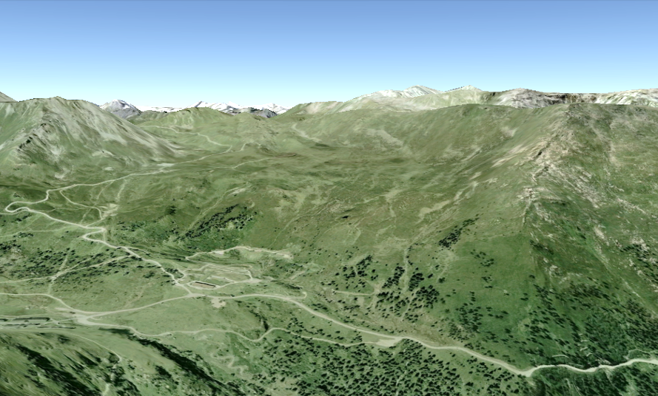
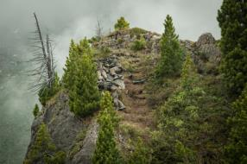
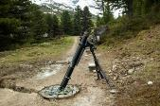
FEBA „W“
Klammspitzen
Mölser Sonnespitze
Mölserscharte
Mölserberg
FEBA
1.
24
FEBA
MINFBN24
6
Res
24
CS
AA „L“
Notes:
The defensive operation by the MINFBN24 is conducted according to this Operation plan.
By showing you the following slides I also want to give you an impression of the training area in case you haven‘t already had the chance to be there personally.
The BN is deployed with 4 combat units. 1st Coy in the FEBA west, including to pockets of resistance at the edges of the defense area.
9

Slide 10
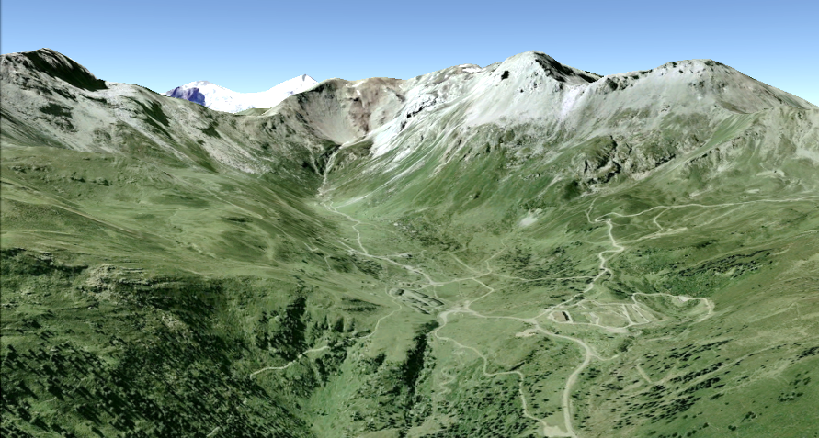
FEBA „M“
Kalkwand
LIzumer
LIzumer
Tarntalerköpfe
Reckner
Sonnenspitze
Pluderlinge
Tarntalerscharte
Klammspitzen
PL GVPL
Junsjoch
PL GVPL
FEBA
1.
24
2.
24
FEBA
3.
24
MINFBN24
Res
24
6
CS
AA „L“
Notes:
The 2nd INFCOY is defending in the FEBA close to the refugee camp, also with 2 pockets of resistance in remote and steep terrain.

Slide 11
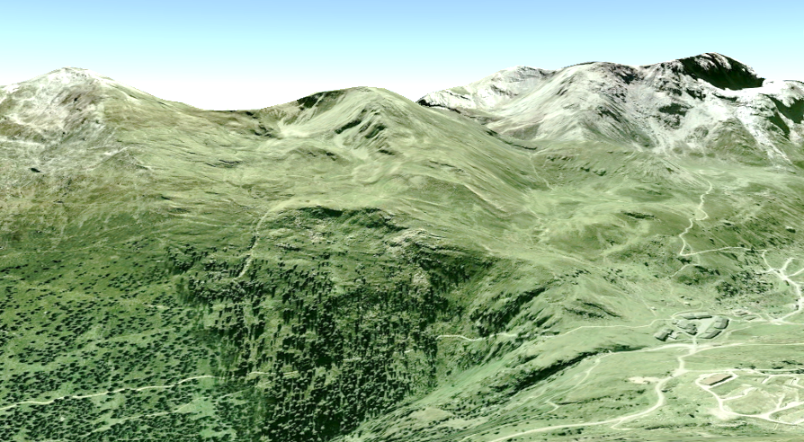
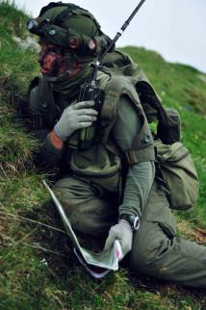
FEBA „E“
Torspitze
Graue Wand
Torwand
Kalkwand
PL GVPL
PL GVPL
FEBA
FEBA
2.
24
3.
24
Res
24
MINFBN24
CS
6
AA „L“
Notes:
The 3rd INFCOY defends in FEBA East.

Slide 12
RESERVE
FEBA
1.
2.
24
3.
24
MINFBN24
Res
24
6
CS
AA „L“
Notes:
The 4th unit, the Combat Support Coy is centrally kept available as the reserve element of the BN.

Slide 13
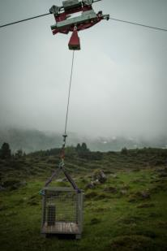
ENGINEER COY
Kalkwand
LIzumer
LIzumer
Tarntalerköpfe
Reckner
Sonnenspitze
Pluderlinge
Tarntalerscharte
Klammspitzen
PL GVPL
Junsjoch
PL GVPL
FEBA
(-)
1.
24
2.
24
2
FEBA
3.
24
MINFBN24
Res
24
6
CS
AA „L“
Notes:
An engineer Coy is supporting the defending elements in the steep col of Tarntaler Scharte by running a ropeway. This is a unique transport asset we have in our engineer BN 2 in Salzburg.
Additionally the ENGCOY supports by obstacle, and demining capacities.

Slide 14


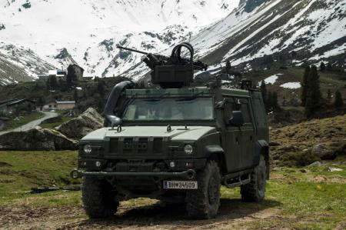
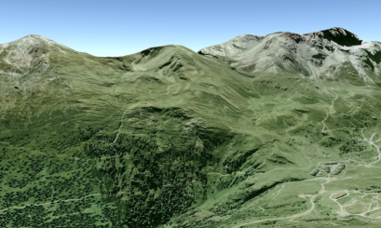
RECCE PLATOON (IVECO)
FEBA
FEBA
1.
FEBA
1.
24
3.
24
2.
24
Res
24
MINFBN24
6
6
CS
AA „L“
CS
RES 24
PL GVPL
PL GVPL
FEBA
FEBA
2.
24
3.
24
CS
Res 24
6
Notes:
Additionally to the organic recce platoon of the INFBN24, a motorized recce platoon from the RAB3 provides technical surveillance and recce capacities.

Slide 15
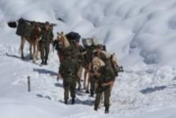
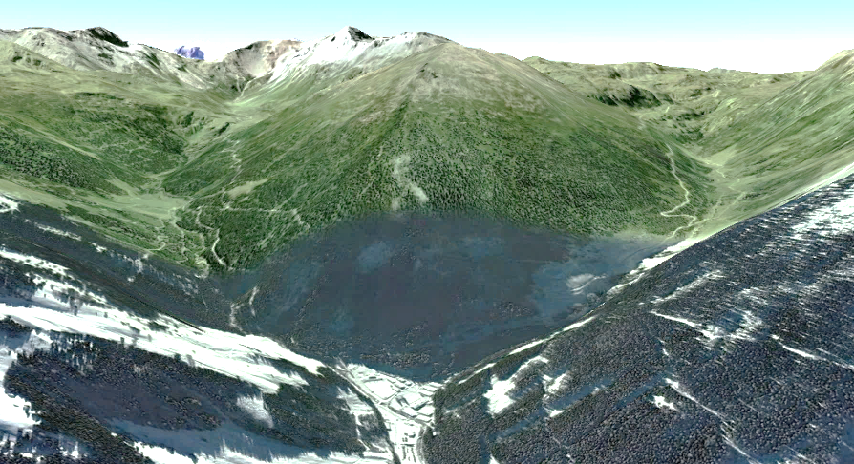
SUPPORT COY
Mölserberg
MINFBN24
6
AA
MSR
HAWK
LOC
MULE
BNSA
Notes:
The support company supports from a BNSuport area in Walchen. An important unit for transport and also surveillance tasks is the pack horses platoon from the HQBN 6.

Slide 16
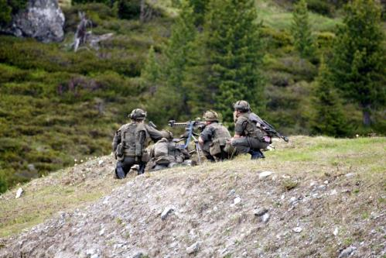
THIS CONCLUDES THE 1st PART
Notes:
Pending your questions gentlemen, this concludes part one of my briefing.

Slide 17

FTX CAPRICORN 16
Outlook
Presentator: COL ZWEIKER Klaus
Function: DepBrigCdr
Date: 10 jun 15
Place: Hochfilzen
Notes:
Gentlemen I now want to give you an outlook for the next years Exercise CA16.

Slide 18
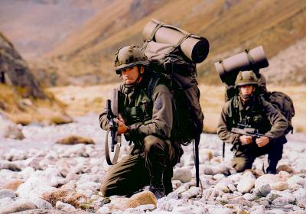
AGENDA
INTRODUCTION
SITUATION
PLANNING OF EXECUTION
INTERNATIONAL PARTICIPATION
Notes:
I’ll follow this Agenda:

Slide 19
INTRODUCTION (1)
PURPOSE:
Execution of different life firing exercises embedded in a LIVEX
Training of the combined arms battle
AIM:
Improve the operational readiness of the Brigade in the combined arms battle
Train life firing skills of mountain troops
Enhance Interoperability
Notes:
The purpose of the exercise will be…
The aims derived from this purpose are:…

Slide 20
INTRODUCTION (2)
Time:
  30may16 – 03jun16: Preparatory Phase
  06jun16 – 17jun16: LIVEX
Area: Military training area LIZUM/ WALCHEN
Theme: Life firing in a defence scenario
Weapons: all weapon systems of mountain troops reinforced by combat support weapons
International participation (P&S MTI partners)
Including the CIMIC aspect
20
Notes:
20
The cornerstones of the exercise are as follows:
Time:
Training Area:
Theme:
Weapons:
The exercise will be offered to our international partners represented in the P&S MTI process.
We will also include the Cvil military cooperation aspect in the scenario and execution.

Slide 21
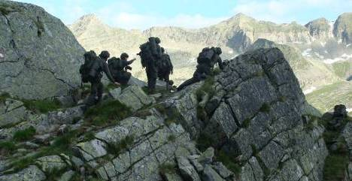
Overall
TACTICAL SITUATION
Similar to CAPRICORN 2015
Notes:
The overall tactical situation is similar to the exercise CAP 15, which I‘ve already presented to you.

Slide 22
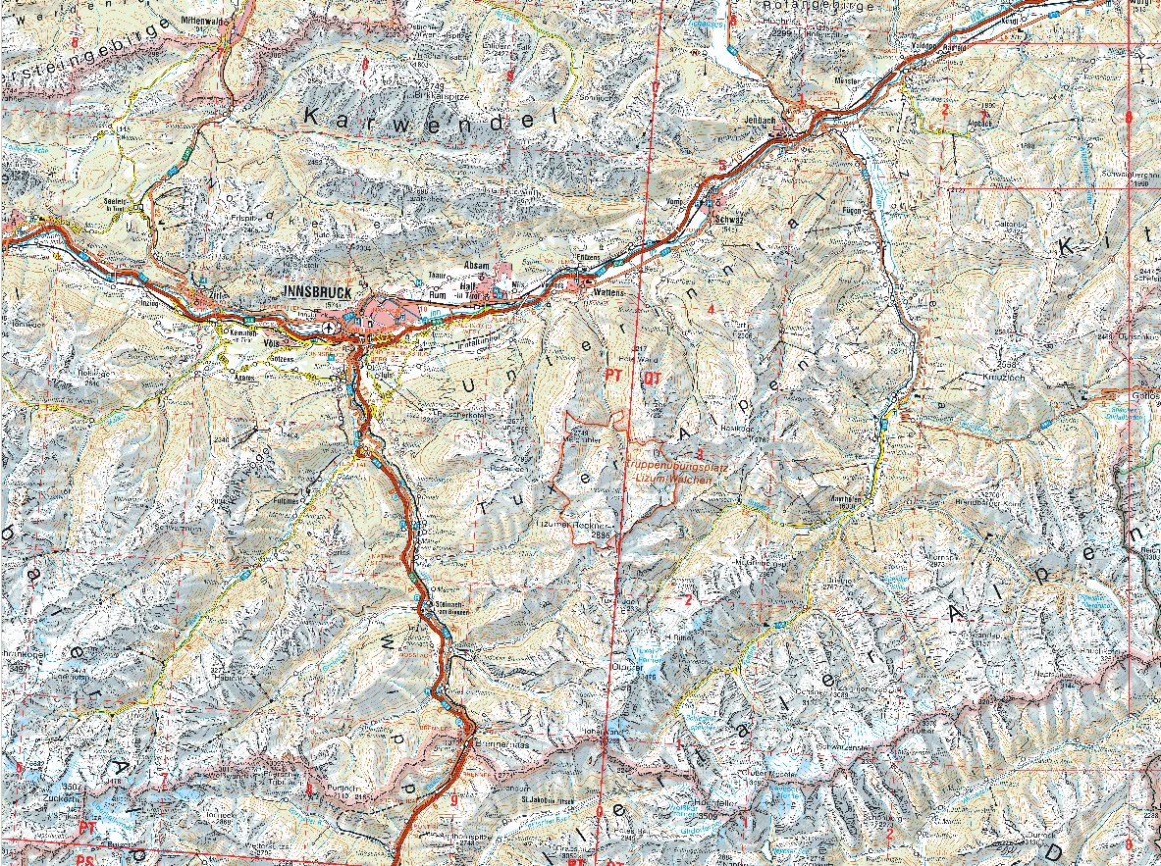
SITUATION
Lumean Minority (20%)
CP
HSF
CP
HSF
Lumean
refugees
HIGHLANDERS (Majority, 80%)
HIGHLAND NATIONAL FRONT (HNF)
nationalist movement
Aim: „mono- ethnic HIGHLAND“
(-)
HNF
Notes:
The General Situation of the LIVEX CAPRICORN is quite simple and no further countrybooks, etc. except the tactical orders will be necessary/ handed out to the participants!
Szenario:
The population of the province of HIGHLAND consists of a LUMEAN minority (20%) in the northern part and a majority (80%) of native HIGHLANDERS. Due to economic problems there was a significant increase of nationalism within the HIGHLAND-majority against ethnic LUMEANS. The LUMEAN minority was accused of exploiting the social system and being responsible for the economic deterioration.
After several encroachments on the LUMEAN minority by nationalist HIGHLANDERS the provincial government decided to deploy its HIGHLAND SECURITY FORCES (HSF) IOT protect the LUMEAN territory from further incidents. A refugee movement of LUMEANs came along with the incidents: LUMEANS within the HIGHLANDER-dominated regions felt insecure and were heading to the northern parts of HIGHLAND (LUMEAN territory). UNHCR established a refugee camp (approx. 450 LUMEAN refugees) IVO LIZUMER HÜTTE and the camp is protected by an UN-platoon.
The aim of the ultra-nationalist “HIGHLAND NATIONAL FRONT (HNF)” is to achieve a “mono-ethnic province of HIGHLAND”. They conducted the encroachments against the LUMEAN minority and announced further attacks.

Slide 23
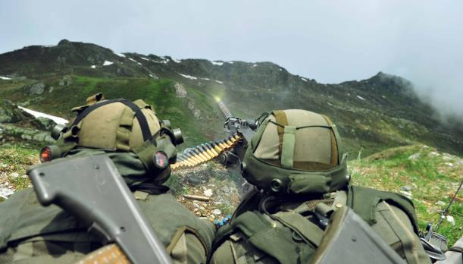
PLANNING of the
EXECUTION

Slide 24

ORGANISATION
Staff
EXCON
2)
6
Troops
JFSCG
BAE
Training Audience
Real life support, Safety organisation
Remarks:
1) incl. 160 conscripts
2) International participants according to the P&S MTI applications
1)
23
6
2
KPE
24
26
ALO
FAC
(-)
EOD
2
JFST
PYRO
MP
2
24
Notes:
The exercise organisation will be set up as depicted on this ORG CHART.
The core element of the Training Audience will be MINFBN 23 of the 6.MINFBDE. It will be reinforced by several Combat and CS elements.
The real life support as well as the required safety organisaton will be provided by the other BN of our BDE.
The most important part of this exercise will of course be the multinational participants. They are invited to contribute both to the training audience nd the Staff and safety organisation.
I‘ll give you more details later.

Slide 25
TIMELINE
30may16 | 31may16 | 01jun16 | 02jun16 | 03jun16 | 04jun16 | 05jun16
Deployment EXCON
06jun16 | 07jun16 | 08jun16 | 09jun16 | 10jun16 | 11jun16 | 12jun16
Deployment Inprocessing Briefings
13jun16 | 14jun16 | 15jun16 | 16jun16 | 17jun16 | 18jun16 | 19jun16
 |  |  | Edelweiss-party | Outprocessing Redeployment Clean up
20jun16 | 21jun16 | 22jun16 | 23jun16 | 24jun16 | 25jun16 | 26jun16
Preparation training area LIZUM
EXERCISE
LIFE FIRING (platoon/coy; rotatory)
Bad weather-reserve
LIFE FIRING (coy)
LIFE FIRING BN
LI/LL
Notes:
The timline for the exercise will be:
The initial deployment of the EXCON will start in the end of may. From 30may to 03jun16 the necessary prepartion of the training area will be organised.
The training audience will have to deploy on 06jun16 followed by the first phase of the exercise focussing on platoon sized life firing exercises on a rotatory basis.
In the second week from 13jun-16jun16 the climax of the exercise will happen in a Battle group live firing exercise.
The Edelweiss-Party will then finally end the first common P&S MTI exercise in AUSTRIA.
We will keep the weekend 11jun-12jun scheduled as a bad weather reserve in case we won‘t be able to finish the 1st week as planned.

Slide 26
SHOOTING RANGES



Constraint:
max. 3 ranges simultanously
26
Notes:
We will have these shooting ranges available, where almost all weapons and ammunition mountain troops are normally employing can be used.
We can shoot an max. 3 ranges simultanously.

Slide 27
1. Week

Ambush
Remark:
CS and enabling elements included:
Mortars
CCA, CAS
Air transport
Engineers
Snipers
…

Defense (plt), hasty counter attack
Defense FEBA (Coy)
27
Notes:
In the first week of the exercise there will be different scenarios offered:
Hasty counter attack in a defence scenario
Responding to an ambush by an escorted convoy both up to platoon level
Defence operation out of positions in a FEBA for coy sized units
According to the application of partner nations, several supporting elements will be integrated:
- Mortars, CAS, CCA, air transport for reserve elements, snipers etc.

Slide 28
2. Week



Defense (Coy)
Defense (Bn)
28
Notes:
In the second week the level of coordination and size of the exercising units will be increased up to Battalion level.
The combined arms battle in a defensive operation will be in the focus. That will also include a counter attack of a company.

Slide 29
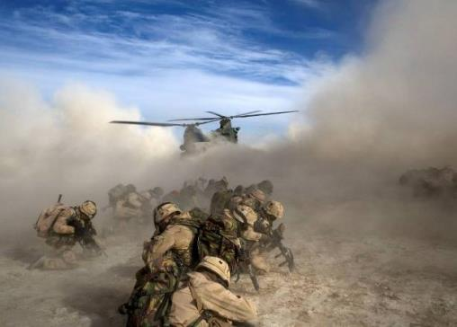
INTERNATIONAL PARTICIPATION

Slide 30
REQUIREMENTS
LIVEX – NO TRAINING!
Fully equipped units:
  Vehicles, Arms, mountain equipment
  Radios
  Night vision devices
  Ammunition (blank-/ live ammunition)
  Safety personnel
Ability to move and sustain in mountainous terrain
English language skills (mainly Cdrs)
Information management via MTI-WebSite
Notes:
The participating nations are kindly asked to notice these requirement:
This is going to be a life firing exercise, no preparatory training prior to the exercise will be offered.
All units should be fully equipped units with:
Vehicles, Arms, mountain equipment,
Radios
Night vision devices
Ammunition (blank-/ live ammunition)
The safety personnel must be available according to AUT national regulations.
The soldiers are supposed to have the ability to move and sustain in mountainous terrain. Please be aware, that the exercise will be in June, where still snow could affect the movement, like it does this year.
We will also be able to offer your units the opportunity to shoot from positions in steep and rocky terrain, which is a very unique feature in this training area.
English language skills mainly for the function of Cdrs will be essential.
All further information will be provided via the MTI-WebSite. So please make sure, you‘ve got the necessary access.
The templates and detailed information requirements like kind and calibre of weapons and ammunition, serial numbers, personal data etc. will be published on the MTI website and sent to the respective POCs of participating nations.

Slide 31
OPTIONS
Mountain Infantry: Squad/Platoon/Coy
Sniper: Squad
Personnel: BN-/BDE Staff, Safety personnel
Enabler: Helicopter, JFS, EOD, Comms, etc.

Slide 32
TIMELINE PLANNING
Declaration of participation:
  Due date: 28 July 2015
IPC:
  29sep-30sep15
MPC:
  January 2016 (TBD)
FPC:
  April 2016 (TBD)

Slide 33
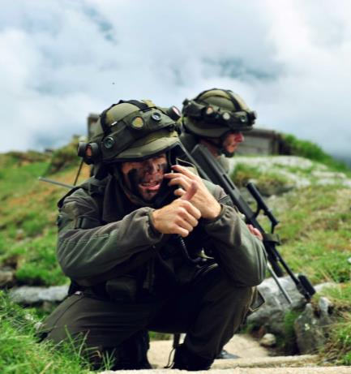
Looking forward to seeing you
2016!

