Slide 1
LTC ZHELYAZKO ZHELEV
Chief expert “Training and Exercise Department”
Bulgarian Land Forces Headquarters
6th Planning Committee Meeting
&
Annual Conference 2020
“EU Pooling & Sharing Mountain Training Initiative”
16 SEP – 17 SEP 2020

Slide 2
AGENDA
Geographical Orientation
Why RHODOPE
Host unit
Relation to other exercise
General Framework
Aims and Training Objectives
Commander`s Intent
Planning Timeline
9. STX Concept
10. Synchronized matrix
11. Real Life Support
12. CIS
13. Legal Aspect
14. Way Ahead
15. Questions

Slide 3
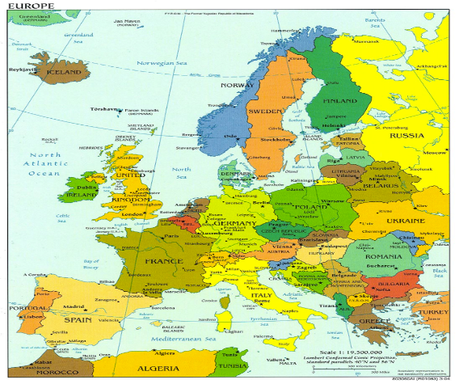
GEOGRAPHICAL ORIENTATION

Slide 4
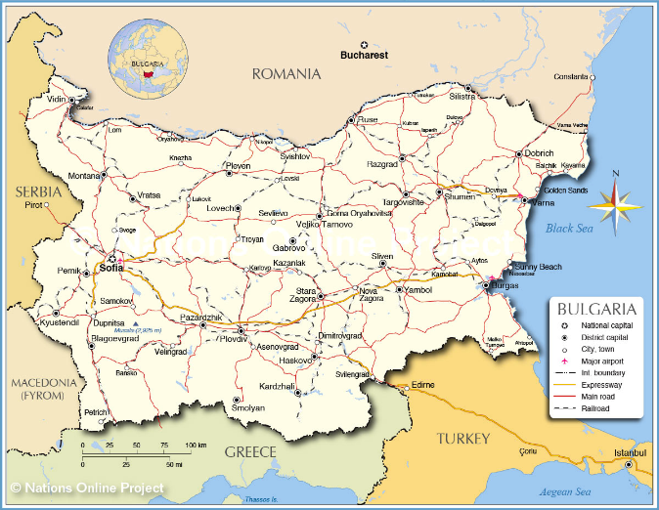
GEOGRAPHICAL ORIENTATION
Balkan Peninsula
Bulgaria
Smolyan

Slide 5
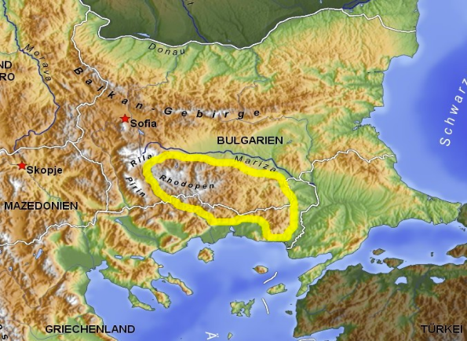
The Rhodope is a mountain range in Southeastern Europe, with over 83% of its area in southern Bulgaria and the remainder in Greece. Golyam Perelik is its highest peak at (2,191 meters (7,188 ft).
Why RHODOPE
Climate
The average annual temperature in the Rhodopes is 13 °C, the maximum precipitation is in December. During winter temperature could drop to -20°C below zero and snow cover could be around 2 meters.

Slide 6
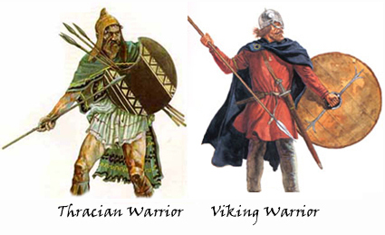
Why RHODOPE
Mythical Land of Warriors and Wine
The Greeks used “Thracians” to denote wild. The Thracians built such an image of themselves because of the endless wars they waged among the different tribes and also with their neighbours. The Thracians were skillful warriors and for that reason they were highly sought after mercenaries.

Slide 7
HOST UNIT
HOST UNIT – 101 ALPINE REGIMENT
SUBORDINATION
XXX
LAND FORCES
COMMAND
101 ALPINE
REGIMENT

Slide 8
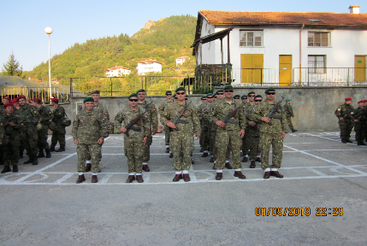
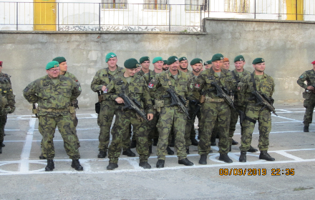
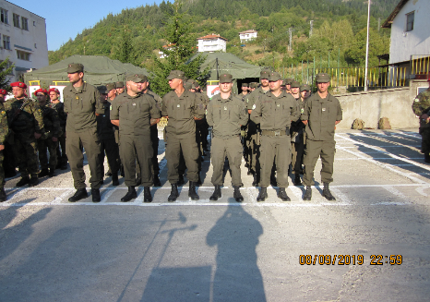
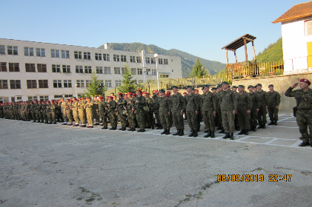
HOST UNIT
RHODOPE 19 – OPENING CEREMONY

Slide 9
RELATION TO OTHER EXERCISE
MCJTE RHODOPE 21 will be the second step of the training for countries’ units, IOT to enhance their capabilities and to be prepared for the main Exercise European Mountain Phalanx 22 (EMP 22) in Austria.

Slide 10
GENERAL FRAMEWORK
RHODOPE 21 will be a multinational combined joint training exercise (MCJTE), executed at the tactical level with up to four alpine companies under multinational battalion command.
It will practice the functionality and deployability of the PTA within a scenario relevant to its mandated mission.
“EU Pooling & Sharing Mountain Training Initiative” with Coordination of BGR LF HQ will lead the MCJTE RHODOPE 21

Slide 11
GENERAL FRAMEWORK
The RHODOPE - 21 is the most important event for 101 Alpine Regiment training according to the training program of Land Forces
The training program is based on a scenario in which international partners are integrated with the regiment’s companies to provide tactical operation IOT reach ordered AO and to demonstrate presence.
The101 Alpine Regiment, into which the international participants are integrated, is tasked with the training of certain aspects of mountain warfare.

Slide 12
GENERAL FRAMEWORK
Officer Scheduling the Exercise (OSE)
COM BGR Land Forces
Officer Conducting the Exercise (OCE)
101 Alpine Regiment Deputy Commander
Officer Co-Directing the Exercise (ODE)
The nature of the exercise, has required that two ODEs exist:
101 Alpine Regiment COS
Officer from Austrian Joint Forces
Officer Primary Responsibilities (OPRs)
Chief expert in L-7 BGR LF HQ

Slide 13
AIMS
Aims of RHODOPE-21 are:
Training and practice of mountain warfare techniques in snowy mountainous terrain;
Demonstrate “EU Pooling & Sharing Mountain Training Initiative”, responsiveness and interoperability within all member countries.

Slide 14
MAIN OBJECTIVES
Consistent with “EU Pooling & Sharing Mountain Training Initiative”, assigned mission and the objectives of RHODOPE 21 are:
PTA to conduct planning at the tactical level.
PTA to practice mountain operations on tactical level.
Commanders from different levels to exercise planning, command and control (C2).
PTA to exercise for certain situations of mountain warfare with regard to the capabilities:
Mobility (flexibility, maneuverability);
Engage (effect);
Sustain (sustainability).

Slide 15
COMMANDER’S INTEND
Land Forces Command conducts this training exercise with:
Infrastructure IVO SMOLYAN, PERELIK
Support of DITS
Integration of international augmentees at LI/LL, by MW COE
Training the MTA on capabilities ENGAGE, SUSTAIN
and MOBILITY in mountainous terrain at platoon to battalion level,
Tasking Logistic Units for Real Life Support IOT enhance capabilities of the participants in mountain warfare techniques.

Slide 16
COMMANDER’S INTEND
Land Forces Command and Multinational Battalion HQ will conduct this training exercise with four phases:
1. PHASE I
Preparation phase / National training (14 SEP 20 – 20 FEB 21),
2. PHASE II
Joint Training / STX (15 – 20 MAR 21),
3. PHASE III
Execution phase/ FTX (23 – 25 MAR 21)
4. PHASE IV
Redeployment

Slide 17
PLANING TIMELINE
01 APR
AAR ---
FTX ---
23 - 25 MAR
21 MAR
– CULTURAL DAY
– STX LINE
15 – 20 MAR
DEPLOYMENT ---
12-13 MAR
16 – 19 FEB 21
– PLANNIG
25 – 28 JAN 21
– FCC
15 – 17 DEC 20
– MPC and Site Survey
13 – 15 OCT 20
– IPC

Slide 18
STX CONCEPT
Exercise 1 – Mobility and Survivability
Day 1 – Mountain Living:
- Planning, preparing and conducting the mission
- Assessing the mountain hazards
- Preserving Combat Power, IOT conduct a follow-on mission.
Day 2 – Mountain movement techniques:
Navigating
Reconnaissance
Route Selection
***HN and SN units are responsible for personal and special equipment

Slide 19
STX CONCEPT
Exercise 2 – Patrolling and Load transfer
Day 1 – Patrolling:
Assessing operational situation
Engagement possibilities
Contact
Break contact
Day 2 – Load Transfer and First Aid:
Building Zip line
Load transfer training
First aid and transportation
***HN and SN units are responsible for personal and special equipment

Slide 20
STX CONCEPT
Exercise 3 – Fire Training
Day 1 – National fire training, according to the Bulgarian Army Regulations
Day 2 – Fire training by exchanging weapons between participating nations
*** HN units are responsible for Fire Training Plan preparation

Slide 21
SYNCHRONIZATION MATRIX

Slide 22
RLS - Medical support
The HN will provide:
Emergency and non-emergency Role 1 medical care on a 24/7 basis.
Role 1
Emergency and basic support (no specialized treatment) includes daily sick call, immediate lifesaving measures, non-battle injury prevention, and patient ground medical evacuation to a local designated medical treatment facility.
Role 2
Military hospital in Plovdiv and civilian hospitals in the region.
Role 3 and 4
Military Medical Academy – Sofia.

Slide 23
RLS
Estimated Coasts
Food: 10 € p/d
Accommodation: 17 € p/d
Additional Costs: depending on TA
Shooting range ~ 3 €, Training area PERELIK
Total per person per day: 30 €

Slide 24
RLS
TBD
during IPC, MPC and FCC

Slide 25
LEGAL ASPECTS
Draft of Technical Arrangement regarding to the Field Training RHODOPE 2021 will be given to all participating countries during IPC / 15 – 17 OCT 20
Remarks, Comments, Proposals – up to MPC / 17 DEC 20 sending via email to BGR LF HQ

Slide 26
Requirements to Sending nations
MTA
Maximum of 1-2 InfPlatoons or Company for every Nation
Own weapons with blank/life ammunition &equipment
Personnel
SNRs of SNs in EXCON
Skill Requirements
The participants have to be able to operate in mountainous terrain.
Language Requirements
The leaders (platoon, company) English STANAG 2222

Slide 27
Way Ahead
Way ahead
Participants request - NLT 10 OCT 20
Initial Planning Conference
– 15 – 17 OCT20 via VTC
Main Planning Conference
– 15 – 17 DEC20 in Smolyan / Bulgaria
Final Planning Conference
– 25 – 28 JAN21 in Smolyan / Bulgaria

Slide 28
Questions to SNs
Which units do you want to participate with?
Size of the unit?
Special training requirements?

Slide 29
Thank you for your attention

