Slide 1
European Mountain Thunder 22
Structure of the Exercise
MTI Expert Talks 05-07may21

Slide 2
Agenda
Exercise Area
Exercise Aims
Exercise Participants
Exercise Schedule

Slide 3
Exercise Area
Military Training Area Lizum/Walchen
Location
Terrain
Infrastructure
Travel Options

Slide 4
Exercise Area
Military Training Area Lizum/Walchen
and surrounding terrain
training terrain above the treeline
partly snow covered in May

Slide 5
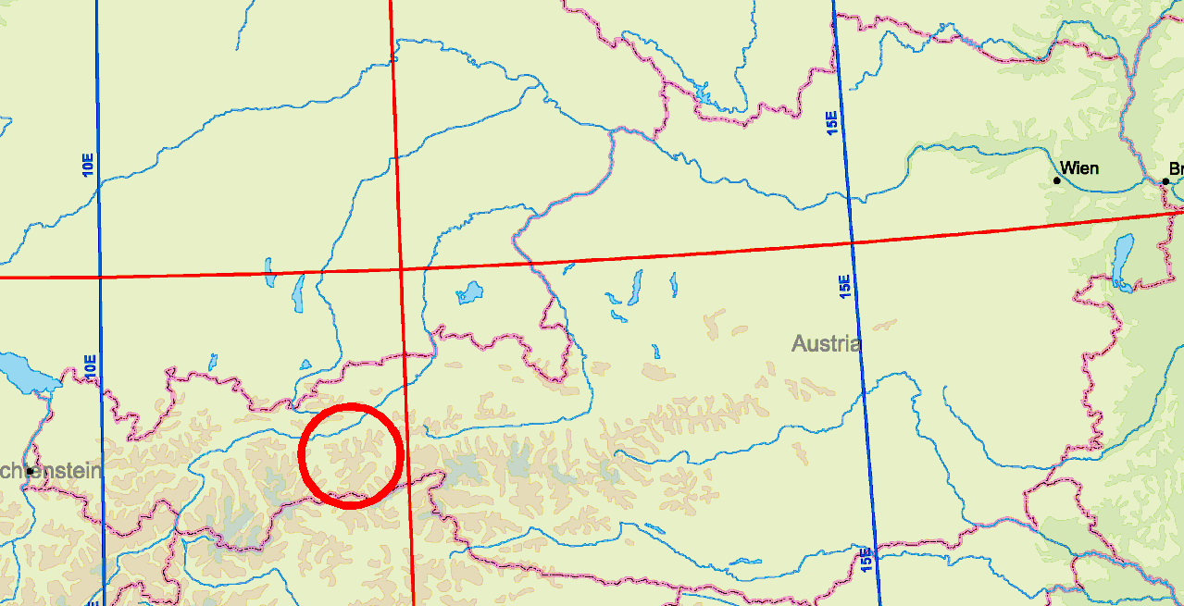
Exercise Area
Location

Slide 6
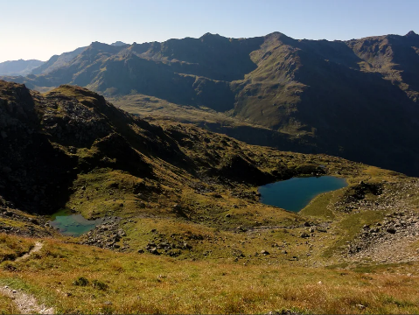
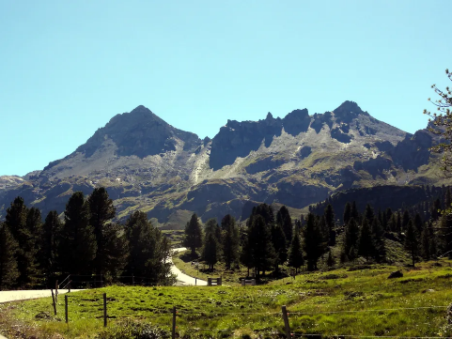
Exercise Area
Terrain

Slide 7
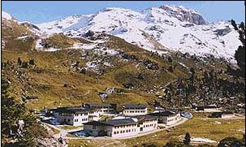
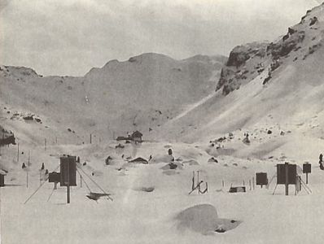
Exercise Area
Terrain

Slide 8
Exercise Area
Infrastructure
Camp Lizum:
2000m ASL
accomodation for 600 personnel
mess hall

Slide 9
Exercise Area
Travel Options
by plane:
international airport Innsbruck IATA: INN, ICAO: LOWI
by train:
Innsbruck railway station
by car or bus:
autobahn exit Wattens, 12km road to MTA Lizum

Slide 10
Exercise Aims
recconaissance
attack
defence
logistics
squad up to bataillon level
in mountainous terrain
above the treeline
several days without infrastructure

Slide 11
Exercise Participants
Branches
mountain infantry

Slide 12
Exercise Participants
Weapons
organic weapons of mountain companies
blank ammunition

Slide 13
Exercise Participants
Equipment
combat equipment
snow shoes, ski poles
avalanche transceivers, snow probes, shovels
bivouac equipment

Slide 14
Exercise Participants
Logistics
3 DOS blank ammunition
5 DOS rations
5 DOS cooker fuel

Slide 15
Exercise Participants
Communication
VHF FM Radio
30 – 80 MHz
no encryption

Slide 16
Exercise Schedule
09may arrival, administration, opening ceremony
10-12may squad training:
reconnaissance
march
rock climbing
one bivouac included
13may platoon training: March and hasty attack
bivouac
14may company training: Attack

Slide 17
Exercise Schedule
15may free of military training
16may bataillon training: March to attack area
17may bataillon training: Attack
18may bataillon training: Defence
19may bataillon training: March, closing ceremony
20may travel day

Slide 18
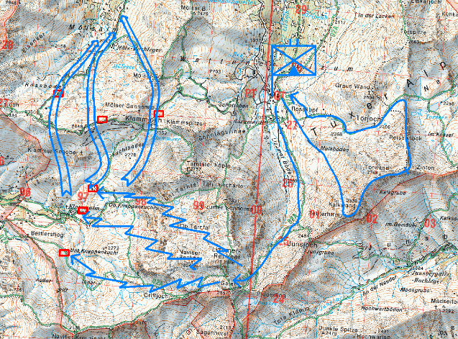
Day 2-4

Slide 19
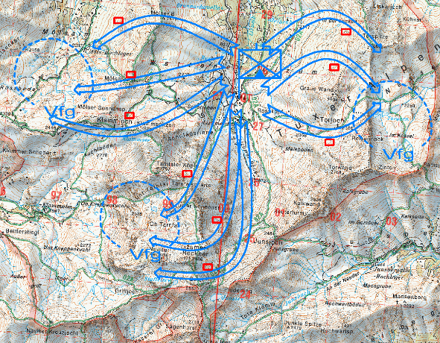
Day 5

Slide 20
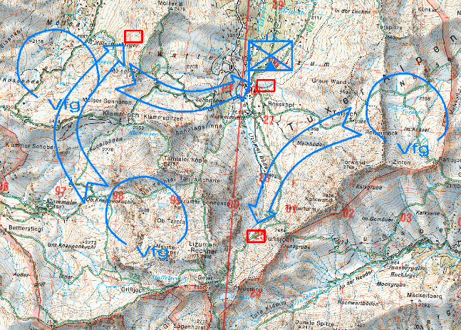
Day 6

Slide 21
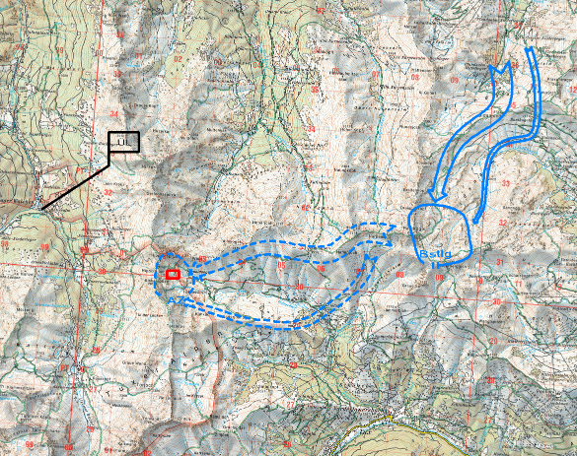
Day 8-9

Slide 22
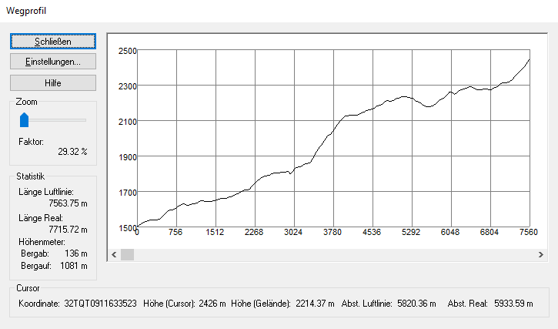
Day 8

Slide 23
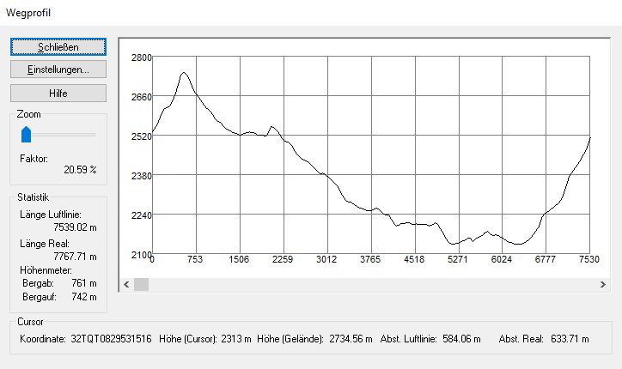
Day 9

Slide 24
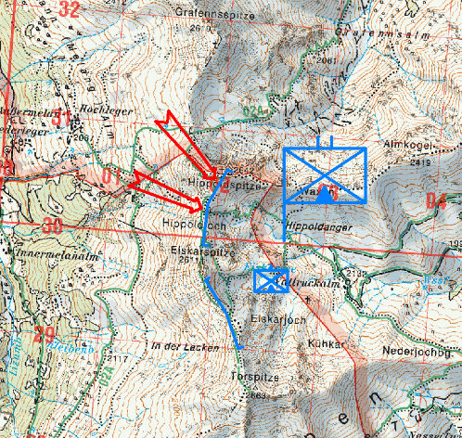
Day 10

Slide 25
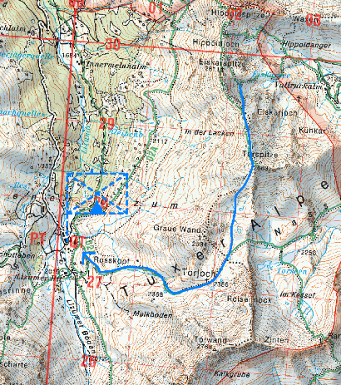
Day 11

